Slide 1

Using the Data Project to Improve Adolescent and Young Adult Health in Your State
NAHIC: National Adolescent and Young Adult Health Information and Innovation Center
University of California, San Francisco

Slide 2
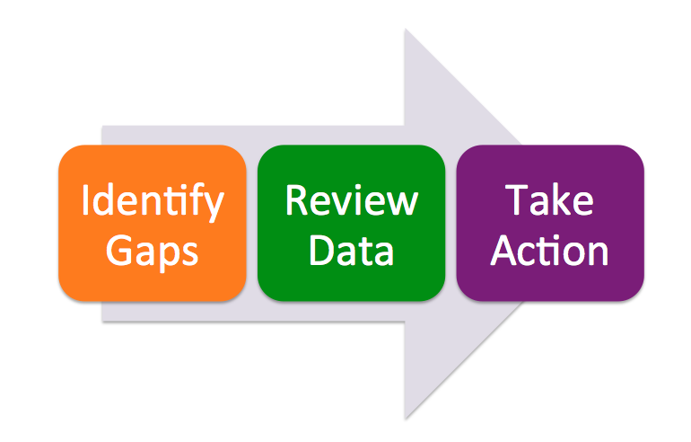
Approaches for Your State

Slide 3
Approaches for Your State
Identify Data Gaps
What objectives are missing data?
What racial/ethnic/gender groups in your state are not adequately captured in the data?
Do other comparable states collect this data?

Slide 4
Approaches for Your State
Perform Data Review
Internally – Is your state making progress?
  By individual objectives
    Changes over time (stable/positive/negative)
    Racial/Ethnic/Gender/Age disparities
  By 2010 Objective clusters
Externally – Are other states making progress?
  Compare your state to the national rates and percentages
  Compare your state to other similar states
Find/investigate success stories
Evaluate current or past programs

Slide 5
Approaches for Your State
Take Action
Advocate for better data
Grant writing (e.g., Title V Needs Assessment)
Evaluate/revamp existing programs
Craft legislation and/other policy, protocol, and programmatic changes

Slide 6
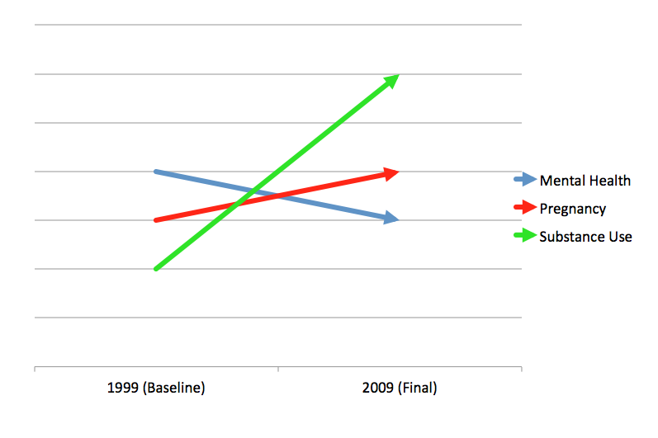
Is Your State Moving in the Right or Wrong Direction?

Slide 7
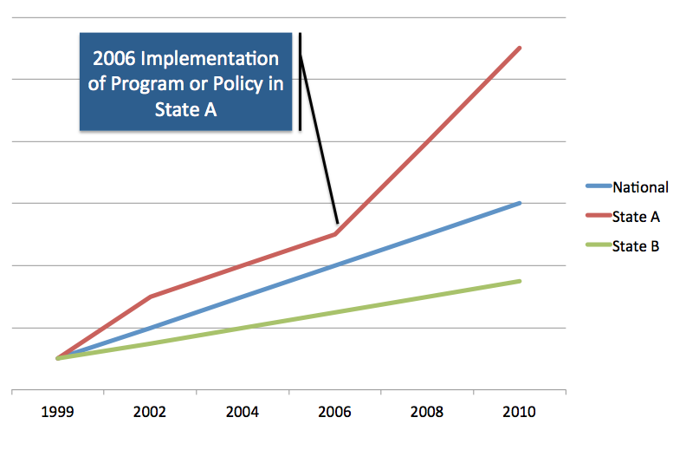
Linking The Data Project To Your State’s Policies/Strategies

Slide 8
What Accounts For The Change?
What was the program/policy implemented?
When was it initiated?
What were the funding levels?
What other factors in the state may have contributed to the increase/decrease?
How do the results square with national trends?

Slide 9
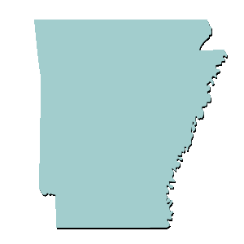
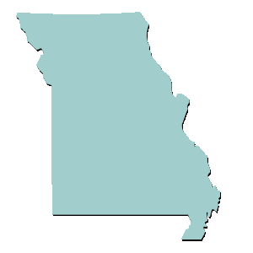
Example: Looking at Missouri and Arkansas
Missouri
Arkansas

Slide 10
Overview: Changes from Baseline to Final
 | National | Arkansas | Missouri
Suicide Attempts | No Change |  | No Change
Motor Vehicle Mortality | No Change
Physical Activity | No Change
Condom Use

Slide 11
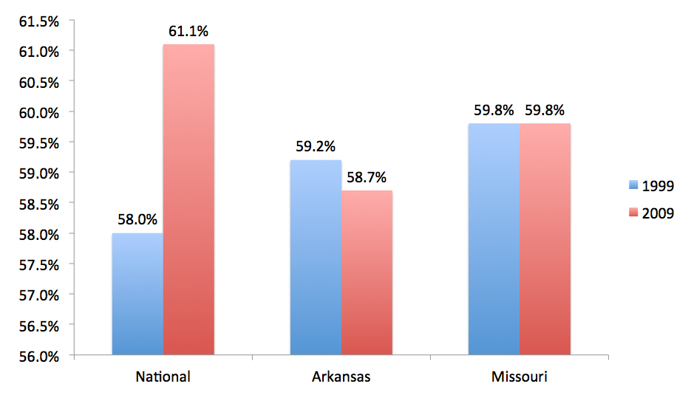
Closer Look: Condom Use at Last Sex
(Among Sexually Active 9th-12th Graders)

Slide 12
By Gender: Condom Use at Last Sex
(Among Sexually Active 9th-12th Graders)
 | Arkansas (1999) | Arkansas (2009)
Males | 67.2% | 72.4%
Females | 51.5% | 47.3%
 | Missouri (1999) | Missouri (2009)
Males | 65.7% | 68.7%
Females | 54.4% | 51.1%

Slide 13
Demographic Disparities:
Missouri and Arkansas
Missouri:
Mortality rates for females increased, compared to a national decline for females.
White adolescents had higher rates of motor vehicle crashes compared to the national rate and rate for Blacks.
Rates of physical fighting for Black males increased from baseline, compared to small declines for all other groups.
Arkansas:
Blacks had decline in safety belt use compared to Whites.
Blacks had higher rates than Whites for suicide attempts, marijuana use, and riding with a driver who had been drinking (in contrast to lower or equal rates nationally).

Slide 14
Positive Signs:
Missouri and Arkansas
Missouri:
Major decline in overall mortality and homicide rates for Black male older adolescents in Missouri (compared to a much smaller national decline).
Missouri reproductive health measures were equal to or better than national rates.
Arkansas:
Arkansas had greater decline in overall mortality than national rate (although rate is still higher than national).
Arkansas had declines in rates of riding with a drinking driver, suicide, marijuana use, binge drinking, and tobacco use.

Slide 15
Conclusion: Use The Data To Mobilize and Build Momentum
Notes:
Jake during the final battle.

Slide 16
Who Is The Data Project For?
Program Administrators and Coordinators
Public Health and other State Officials
Educators
Researchers
Media
Policymakers
Advocates, including youth and their families

Slide 17
Future Vision
Acknowledge limitations of current data
Prepare for 2020 Objectives
Delve deeper (The Data Project is just a snapshot)
Encourage sharing of action steps using the Data Project
Explore opportunities for collaboration (cross-fertilization)
Develop new policies and programs

Slide 18
NAHIC: National Adolescent and Young Adult Health Information Center
WEB SITES
  NAHIC: http://nahic.ucsf.edu
  EMAIL
  urquhartj@peds.ucsf.edu
  PHONE
  (415) 502-4856

