Slide 1
NST 1: Increase the rate of AYA Well Visits
Notes:
Charlie:

Slide 2
Session Overview
What Do We Know?
Promoting the Value of the Visit
Examples of Strategies
QI & Data: A quick overview

Slide 3

What Do We Know?
Promoting the Value of the Visit:
Examples of Strategies
QI & Data: A quick overview

Slide 4
Who Values the Well Visit?
Everyone agrees that annual well visits are a crucial aspect of maintaining good health. But according to doctors, only about half of teens follow this recommended protocol. Overwhelmingly, doctors and pharmacists believe that teens don’t go to the doctor unless they feel sick; and even a majority of teens (and a sizeable minority of parents) agree.
Eight out of ten Physicians think that teens should have a well visit once per year, however…
Physicians say just 56% of teens come in for annual well visits
44%
I don’t see why I should see a doctor or other healthcare provider if I feel healthy
58%
I only see a doctor or healthcare provider when I feel sick
34%
I don't see why my son/daughter should see a doctor or other healthcare provider if he/she feels healthy
41%
My son/daughter should only see a doctor or other healthcare provider when he/she feels sick
(% strongly/somewhat agree)
Source: Unpublished data from Unity Consortium: http://www.unity4teenvax.org .

Slide 5
Adolescents trust their parents
Adolescents trust and value their parents as a source of health information.
They rely on parents for scheduling clinic visits.
They want their parents engaged in decisions about their health and health care.
Source: Unpublished data from Unity Consortium: http://www.unity4teenvax.org .
Notes:
Charlie

Slide 6
Some barriers for obtaining a well visit
Parents and adolescents may believe the family cannot afford a well visit and preventive services (e.g., may not be aware there is no co-pay for many preventive services, such as vaccines).
If a child sees a specialist regularly, parents may believe their adolescent does not need a regular checkup.
Source: Aalsma MC, Gilbert AL, Xiao S, Rickert VI. Parent and adolescent views on barriers to
adolescent preventive health care utilization. J Pediatr 2016;169: 140-5.
Notes:
Charlie

Slide 7
Adolescents value confidential care
Adolescents will forego needed care, when they believe confidentiality is not assured.
Source: Ford CA, Bearman PS, Moody J. Foregone health care among adolescents. JAMA. 1999; 282(23): 2227-34.
Notes:
Charlie

Slide 8
Young Adults &
Preventive Services:
What do we know?
Notes:
Charlie

Slide 9
What Do We Know?
Promoting the Value of the Visit
Examples of Strategies
QI & Data: A quick overview

Slide 10

PUT
“Change the attitudes of adolescents and their parents to encourage them to prioritize prevention health and annual checkups.”
National Foundation
Infectious Diseases – Pfizer
Notes:
Glynis: a tall order!

Slide 11
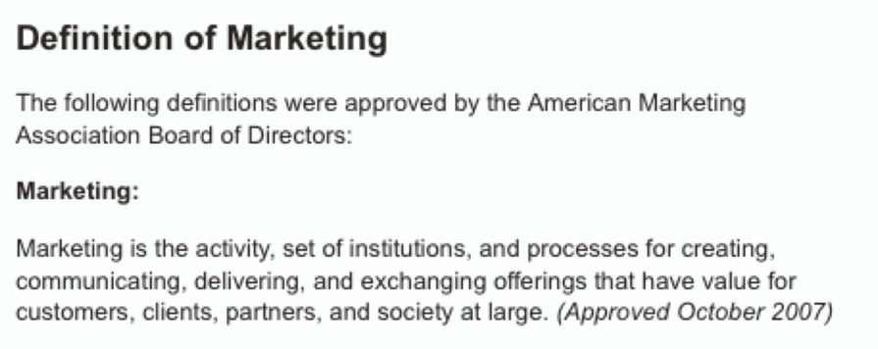
how you get people to buy your stuff
Price
Product
Promotion
Place
vs
what you say about
your product
to get them to do something
you?
Notes:
Glynis: Marketing overview
http://time.com/money/4320098/zoom-health-insurance-millennials/
https://www.colorado.gov/pacific/.../PF_Youth_Youth-Friendly-Clinic-Makeover.pdf

Slide 12
Price
Product
Promotion
Place
Notes:
Glynis: This document gives us a head start – more of launching place for your own work
Read all subheads, describe what I mean by the softer ones. – SELL NST #1 calls!!
Created product components: bright futures +
Segue to PRODUCT related areas
CHARLIE/JANE – if this has already been discussed, I will be BRIEF and echo prior. I
If you want to just jump in here (instead of or in addition to prior) to cover key points: GREAT!

Slide 13

price matters
Notes:
confidentiality / private time
emotional response from young people / parents

Slide 14
place matters
Notes:
CRITICAL but not enough
example
https://www.colorado.gov/pacific/.../PF_Youth_Youth-Friendly-Clinic-Makeover.pdf

Slide 15


product matters
Perceived lack of confidentiality and restrictions (parental consent/notification)
Poor communication by providers
Insensitive attitudes of care providers
Lack of provider knowledge, skills
Lack of money, insurance, and transportation
Inaccessible locations and/or limited services
Limited office hours
Notes:
THIS WE KNOW!!!
Additionally, adolescents face many structural and external barriers that may limit access and willingness to utilize health services.
Primarily, confidentiality concerns can significantly limit health care utilization for adolescents. A recent study of girls younger than 18-years-old attending family planning clinics found that 47% would no longer attend if their parents had to be notified that they were seeking prescription birth control pills or devices, and another 10% would delay or discontinue STI testing or treatment. [i]
Clinician-related barriers also exist, including insensitive attitudes on the part of providers, lack of knowledge and skills regarding reproductive and sexual health, insufficient or inadequate communication, and clinician discomfort with the discussion of sexual behavior with adolescents. [ii]
Since teenagers often rely on others for transportation, geographically inaccessible locales can be formidable structural barriers to care.
Sources:
[i] Reddy DM, Fleming R, Swain C. Effect of mandatory parental notification on adolescent girls’ use of sexual health care services. JAMA 2002;288:710–4.
[ii] Huppert JS, Adams Hillard PK. Sexually transmitted disease screening in teens. Curr Womens Health Rep 2003;2:451–8.

Slide 16


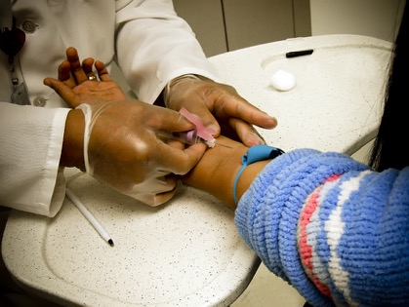




audiences & roles
health systems
faith leader
clinical community
young adults
state systems
adolescents
community
partners
parents
Notes:
GLYNIS:
Talk through role of each audience; touch on role in marketing mix – set up specific strategies shown to have some impact

Slide 17
Standards/requirements
health systems
faith leader
Clinic “pull”
clinical community
young adults
Incentives
Extended sales force
state systems
Youth engagement
Social media/technology
community
partners
parents
Notes:
GLYNIS
Strategy: change the rules, sports physical, STI testing, etc

Slide 18
generational generalizations
1964
1981
2001
Boomers
ages: 53–70
Gen X
ages: 36–-52
Millennials
ages: 15–35
Founders•iGen•Gen Z
ages: 14–10*
Older
Younger
parents of adolescents (20–40)
1958–1986
adolescents (10–18)
1998–2006
young adults
(18-25)
1991–1998
parents of YA (20–40)
1951–1978
1960s | 1970s | 1980s | 1990s | 2000s | 2010s
Notes:
GLYNIS: speaking of YE (marketing series)

Slide 19

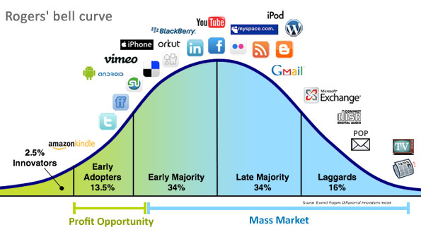
early adopters
Notes:
GLYNIS: because wowsa!
For Snapchat to go from 3% to 23% in four years is incredible growth. 2013, 2016
Tom shares one of the biggest findings from The Infinite Dial. He says when you look at the total population, Snapchat is the 4th-largest social platform. However, when you look at 12- to 24-year-olds, Snapchat is the #1 social platform. This is the first time in The Infinite Dial’s history that Facebook was not #1 in any demographic. Snapchat is used by 72% of 12-24s, whereas Facebook is used by 68%.
﻿http://www.socialmediaexaminer.com/snapchat-and-podcasting-growth-what-the-research-reveals-tom-webster/

Slide 20

Yes, yes, no
Under 26?
Poll
Confident explainer

Slide 21

Yes, yes, no
What is this logo?
What do the dots do?

Slide 22



Yes, yes, no
Who is this?
What box would this person check under “gender”

Slide 23

Yes, yes, no
Where would you find this?
Who made it?
Who uses it?

Slide 24
What Do We Know?
Promoting the Value of the Visit
Examples of Strategies
QI & Data: A quick overview
QI/PDSA Cycles
Quick refresher: Cohort 1 NST#1 Measure

Slide 25
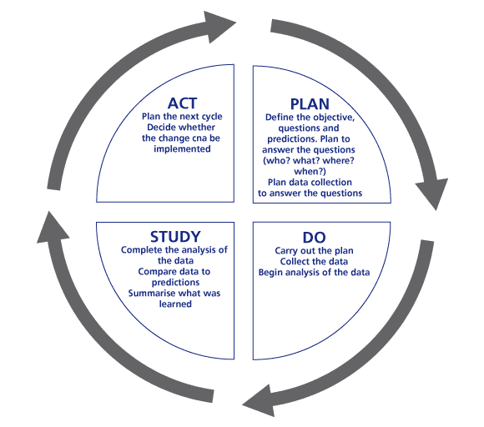
PDSA Cycles and NST 1
Vermont (VT) CoIIN 1 team wanted to develop materials to promote the well visit for adolescents and young adults.
Used the PDSA cycle
Notes:
PDSA Cycles are at the core of QI.
Once again, The cycle starts with
PLAN- Define the objective, questions, and predictions. Plan how to answer the questions? Plan data collection. This may involve baseline data collection. For example in NST#1, our aim is to increase rates of adolescent well visits by 5%. Before any DO activity in the clinic takes place, we have to know what the base rate is so that we can see if our DO activity results in the desired change- increase in the adolescent well visit.
DO- Implement your plan, collect the data, begin analysis of the data
STUDY- Complete analysis. Compare the data from before the DO activity to the data that came after the activity. Summarize your findings.
ACT- Plan the next cycle. Decide whether the change can be implemented.

Slide 26

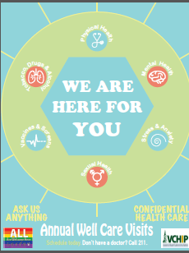
PDSA Cycle
 | Cycle 1 | Cycle 2 | Cycle 3
Plan | VT CoIIN team will develop a poster to promote the AYA well visit | YHAC will design poster in collaboration with YA graphic designer | CoIIN team will distribute to practices YHAC will hang up in school, libraries, etc.
Do
Study | Youth Health Advisory Council (YHAC) reviewed and did not like | VT CoIIN team reviewed & loved it | Are posters still there after 1 mo. Does AYA well visit rate increase
Act | Abandon design | Adopt design | Adapt? Adopt? Abandon?

Slide 27
Refresher: NST 1 Overarching Goal
Aim Statement:
By Spring 2017, we will we will increase the rate of those Adolescents and Young Adults (ages 10-25) covered by Medicaid that utilize preventive services (evidenced by receipt of a well-visit) by 5% above baseline in our clinic demonstration/ CoIIN sites.
Metrics for this aim (from reporting templates)
Numerator: In the reporting period, number of Medicaid recipients ages 10-25 who received an adolescent well visit at a CoIIN site.
Denominator: In the reporting period, number of Medicaid recipients ages 10-25 who are patients of the CoIIN site
Notes:
Charlie

Slide 28
NST #1: Measures & Resources
Communications planning tools
NST#1 Calls
Colleagues from CoIIN#1
Customized TA
Learning Community Webinar Series
  Health Care 101
  Marketing the Well Visit
Notes:
GLYNIS/ILIANA

Slide 29
Discussion Questions
1
2
Discuss your team's readiness to:
Engage young people on your team? (How are you ensuring that they can be successful?)
Market the well visit? (Whether that means a media campaign, engaging young people or community partners)
Work directly with clinics to take advantage of AYAs and families as current patients? (reminders, sports physical upgrade/conversion, leverage acute care visits)
Does this information
(about YE, family, NST1)
change or support
your current plans?
What? How?
Talk through positives and negatives.
3
What do you want to know more about?
What resources do you need in order to take strategic steps forward?

