Slide 1
Adolescents and Young Adults in Title V Transformation:
Understanding Needs, Designing and Selecting Measures and Achieving Outcomes
Adolescent and Young Adult Health
National Resource Center and Maternal Child Health Bureau
AMCHP MEETING
JANUARY 24, 2015

Slide 2
Charles E. Irwin,Jr.,MD*
Claire D. Brindis,DrPH*
Judith Shaw, EdD,MPH,RN**
with thanks to:
Jane Park, MPH and Fion Ng*
Maritza Valenzuela, MPH, CHES, AMCHP***
*Division of Adolescent and Young Adult Medicine
UCSF Benioff Children’s Hospital
University of California, San Francisco
**University of Vermont
National Improvement Partnership Network
***Association of Maternal and Child Health Programs

Slide 3
Acknowledgements
Funder: Maternal and Child Health Bureau, Health Services and Resources Administration, USDHHS (cooperative agreement U45MC27709)

Slide 4
Session Outline
What are Adolescents’ and Young Adults’ (AYAs) Health and Health Care Needs?
How do AYAs fit into MCH 3.0?
Spotlight on Well-Visit/Preventive Visits:
  What’s new in AYA health?
  What does it mean for me? Exploring strategies for access and quality.
What support is available for other AYA Performance Measures?

Slide 5
Section I
What are Adolescents’ and Young Adults’ (AYAs) Health and Health Care Needs?
A lifecourse perspective
Notes:
Adolescences has been recognized as a critically important period of the life course and more recently there is an emerging consensus that the period of young adulthood is also a critically important component.
LOOK AT GRANT LANGUAGE.

Slide 6
Adolescent & Young Adult Development
Significant period of biopsychosocial development.
Normal experimentation with and adoption of adult behaviors and identities:
  Time to foster healthy choices, life skills, & nurturing relationships to help youth thrive as adults;
  Without needed support, risk of negative development and outcomes.
Notes:
SUPPORT OF FAMILIES, COMMUNITIES AND THE BROADER ENVIRONMENTAL CONTEXT HELP IN ACHIEVING GOOD OUTCOMES

Slide 7
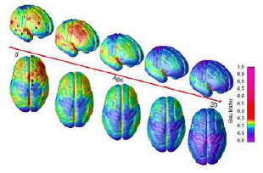
AYA Brain Development
Brain development now extends into the young adult years
Most of this development occurs in the frontal lobe
  Executive functions
  Planning
  Reasoning
  Impulse control

Slide 8
Health Issues of
Adolescence & Young Adulthood
The major health problems of adolescence and early adulthood are largely preventable.
Many problems are linked to behaviors and related outcomes.
Few youths have serious impairment that interferes with daily functioning, BUT
Those with chronic conditions, including mental health disorders, are learning to manage these conditions with increasing interdependence.
Notes:
SPECIAL HEALTH CARE NEEDS
INTERDEPENDENCE – NO ONE IS EVER FULLY INDEPENDENT & THE LANGUAGE THAT WE ARE USING IS MORE REFLECTIVE OF HOW ALL OF US NEED TO FUNCTION

Slide 9

Critical Health Issues of Adolescence & Young Adulthood*
Increasing independence in habits related to diet, physical activity, and sleep.
Period provides opportunity to prevent chronic conditions of adulthood, in areas such as
  Tobacco use,
  Obesity,
  Oral health,
  Hearing loss.
*Adapted from the Healthy People 2020 Core Indicators for Adolescent and Young Adult Health
Notes:
MAY SEEM THAT THIS IS CONFUSING AT BEST GIVEN MY LAST STATEMENT ABOUT INTERDEPENDENCE BUT WE ARE TALKING ABOUT INCREASING INDEPENDENCE WHICH IS DIFFERENT THAN FULLY INDEPENDENT.
CALLED OUT A FEW CONDITIONS WITH DIRECT RELATIONSHIP
WE COULD CALL OUT MORE SUCH AS SUBSTANCE USE, PREMATURE SEXUAL ACTVITITY WITH UNSAFE SEX BEHVAIOR

Slide 10

Critical Health Issues of Adolescence & Young Adulthood
Motor vehicle crashes & drinking and driving.
Violence, including homicide, fighting & intimate partner violence.
Reproductive & sexual health, including behaviors to prevent STIs, HIV/AIDS & unintended pregnancy.

Slide 11

Critical Health Issues of Adolescence & Young Adulthood
Critical period for emergence of mental health concerns, such as:
  Depression;
  Suicide and suicide attempts.
Substance use, including binge drinking & use of marijuana & other illicit drugs.

Slide 12

Most markers of adolescent health worsen in young adulthood.
Many measures peak, including:
Fatal motor vehicle crashes and homicide.
Drinking and driving.
Most measures of substance use/abuse.
Many sexually transmitted infections.
Park et al., 2006: Park et al., 2014
Notes:
MENTAL HEALTH CONDITIONS CONTINUE TO INCREASE IN YA BUT DON’T NECESSARILY PEAK – e.g. psychotic disorders & depression

Slide 13


Slide 14
Mortality by Cause, Gender & Age Group,
Ages 15-24, 2012
Rate per 100,000
Ages 15-19
Ages 20-24
CDC Wonder

Slide 15
Past-Month Substance Use,
Ages 12-25, by Age, 2013
National Survey on Drug Use and Health, 2013

Slide 16
Heavy Past-Month Alcohol Use, by Age, 2013
NSDUH, 2013

Slide 17
Past-Year Major Depressive Episode, by Age and Sex, 2013
National Survey on Drug Use and Health, 2013

Slide 18
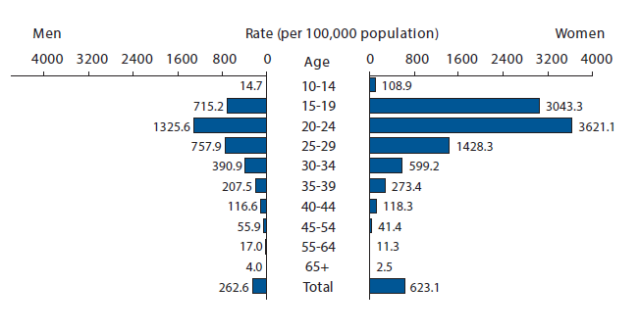
Chlamydia—Rates by Age and Sex,
United States, 2013

Slide 19
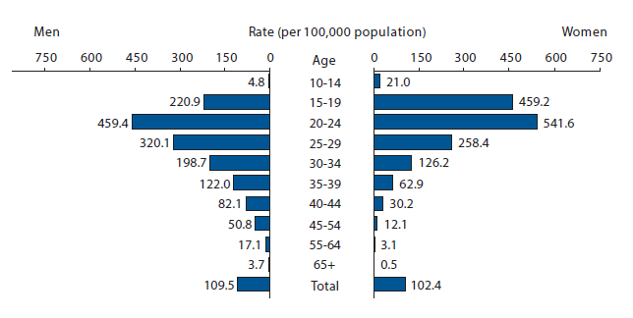
Gonorrhea—Rates by Age and Sex,
United States, 2013

Slide 20
Have a Usual Source of Health Care by Age and Sex, 2012
National Health Interview Survey, 2012
Notes:
And even with the history that we have portrayed of increasing risk – our YA are much more likely to not have a usual source of care with Males>Females. Females probably have greater access because females have greater sources of entry into care.

Slide 21
Full Year Insured by Age and Sex, 2012
National Health Interview Survey, 2012
Notes:
And less likely to be insured – this slide does include the first year of the ACA expansion.
With Medicaid expansion in some states, we may see increased expansion of coverage for YA.

Slide 22
Global burden of disease in young people aged 10-24 years: A systematic analysis
 | 10-14 years | 15-19 years | 20-24 years
1 | Depressive disorder | Depressive disorder | Depressive disorder
2 | Lower RTI | Schizophrenia | RTA
3 | RTA | RTA | Violence
4 | Asthma | Bipolar disorder | HIV/AIDS
5 | Refractive errors | Alcohol use | Schizophrenia
6 | Iron deficiency anaemia | Violence | Bipolar disorder
7 | Falls | Self-inflicted injuries | Tuberculosis
8 | Migraine | Panic disorder | Self-inflicted injury
9 | Drownings | Asthma | Alcohol use
10 | Diarrhoeal diseases | HIV/AIDS | Abortion
Prevention
Gore et al., 2011

Slide 23
Adolescent /
Young Adult Health
Accidents & injury
Mental health & well being
Sexual health
Substance use
Chronic illness
Obesity & eating disorders
Prevention - early intervention - clinical care
Notes:
AK Comp - Irwin - Slide Presentations 2009 - CEI Unique Care 10-16-09 AK revAK Comp - Irwin - Slide Presentations - CEI Unique Care of Adolescent 10-16-09AK Comp - Irwin - Slide Presentations - Slides 2009 - CEI -Masland - AK Rev 10-15-2009
Slide captures the breadth of what we are confronting during this time in the lifecourse

Slide 24
How Health Care Can Help
As they transition out of adolescence, youth are beginning to
  assume responsibility for their care,
  learn to navigate the health care system.
Developmentally-based health care may help
  reduce mortality and morbidity -- including incidence of chronic illnesses -- by decreasing health-damaging behaviors & promoting healthy behavior.
  improve management of chronic conditions.

Slide 25

The Adolescent Preventive Visit:
20 years of consensus & growing evidence base
Guidelines in Bright Futures, 3rd edition, endorsed by major health professional groups
4th edition expected due late 2015 (more on that later)
Growing evidence for:
  Effectiveness of services in positive health outcomes
  Health system interventions to increase clinicians’ delivery of services
Hagan, Shaw & Duncan, 2008; NHIS 2012

Slide 26
The Young Adult Preventive Visit:
Less focus and recent progress
Little professional focus or consensus.
Most adult guidelines are specific to disease (e.g., diabetes, heart disease) not age.
No single source of recommendations like Bright Futures for the pediatric population.
  US Preventive Services Task Force (USPSTF) finds strong evidence supporting preventive services in several areas, such as tobacco, sexual health, and mental health.
  For ages 18-21, Bright Futures recommends screening in areas with less evidence (e.g., injury prevention and illicit drug use).
Hagan, Shaw & Duncan, 2008; Ozer et al., 2012

Slide 27
Differences between Adolescent and Young Adult Health Care
Adolescents |  | Young Adults
Identified health care provider - pediatricians. |  | No identified health care provider especially for males.
Financial system in place. |  | Financial system emerging.
Organizational structure for care exists. |  | No identified organizational structure for care.
Not high users of non-traditional sources of care. |  | High users of non-traditional sources of care.
Minors under age 18; parents play major role. |  | Rights and responsibilities change after age 18.

Slide 28
How do AYAs fit into The Title V Block Grant Transformation?
PART II.

Slide 29
PART III
Spotlight on Preventive Services
WHAT’S NEW IN Adolescent and Young Adult Health?
Affordable Care Act
Update on Guidelines & Vaccinations
Measuring the Preventive Visit: More options
Consumer resources

Slide 30
AFFORDABLE CARE ACT
Expanded Access
Support for Preventive Services
    Park et al., 2011

Slide 31
Expanding Access: Medicaid
Most adolescents in families with incomes up to 133% of the federal poverty level (FPL) will be eligible for Medicaid
Access to Medicaid for the poorest young adults will largely depend on whether their state opts to expand Medicaid to 133% FPL.
  Pre-ACA eligibility levels for childless, non-disabled adults are very low

Slide 32




Expanding Access: the Marketplace
State-based Insurance “Marketplace”
  Individual and small groups can purchase insurance.
  Costs can be defrayed for individuals with incomes between 100% and 400% FPL.

Slide 33
Expanding Access:
More ACA Provisions for Young Adults
States must extend Medicaid coverage to youth aging out of foster care up to age 26 (who were enrolled in Medicaid on their 18th birthday)
Most private plans must offer dependent coverage for young adults up to Age 26
Marketplaces must offer Catastrophic plans for young adults (up to age 29).

Slide 34
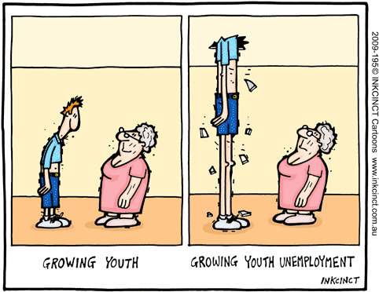
Expanding Access: Challenges
In states that are not expanding Medicaid, vulnerable populations will continue to have limited access to healthcare
  High rates of part-time employment and unemployment among these populations → low rates of employer-based insurance

Slide 35
ACA and Preventive Services
Most private plans must cover certain preventive services, with no cost-sharing.
These services are drawn from:
  For adolescents (and younger children): Preventive Services recommended by Bright Futures, 3rd Edition
  For all adults: Preventive Services recommended by the U.S. Preventive Services Task Force (“A” or “B” rating)
  For women: Services from the Women’s Preventive Services Guidelines
  For all ages: Immunizations (CDC-ACIP recommended)
A complete list of services is available at: http://www.healthcare.gov/news/factsheets/2010/07/preventive-services-list.html

Slide 36
ACA and Preventive Services
Preventive services that must be covered, with no cost-sharing, including screening and and/or counseling in the following areas :
Alcohol and drug misuse Blood pressure Cervical cancer Contraception** Depression Domestic and interpersonal violence** | Obesity and diet Sexually Transmitted Infections and HIV Tobacco use Vision Well woman visits**
  **Women only
A complete list of services is available at: http://www.healthcare.gov/news/factsheets/2010/07/preventive-services-list.html

Slide 37
Impact of the ACA for young adults
Young adults’ (ages 19-25) rates of insurance coverage increased between 2010 and 2012 from 52.0% to 57.9%.
Young adults rates of a past-year “routine visit” increased modestly between 2009 and 2011 from 44.1% to 47.8%.
Kirzinger et al., 2013; Lau et al., 2014

Slide 38
What’s new in Guidelines?
Bright Futures - 3rd and 4th Editions, prenatal through 21st year
Evidence-based recommendations for Young Adults, 18-25

Slide 39
What’s new in Guidelines?
Bright Futures - 3rd and 4th Editions, prenatal through 21st year

Slide 40

Affordable Care Act:
Section 2713
…requires all health plans to cover, with no cost-sharing
the services are outlined in Bright Futures: Guidelines for Health Supervision of Infants, Children, and Adolescents, 3rd Edition (Hagan J, Shaw JS, Duncan PM eds.)
“with respect to infants, children, and adolescents, evidence-informed preventive care and screenings provided for in the comprehensive guidelines supported by the Health Resources and Services Administration,”

Slide 41
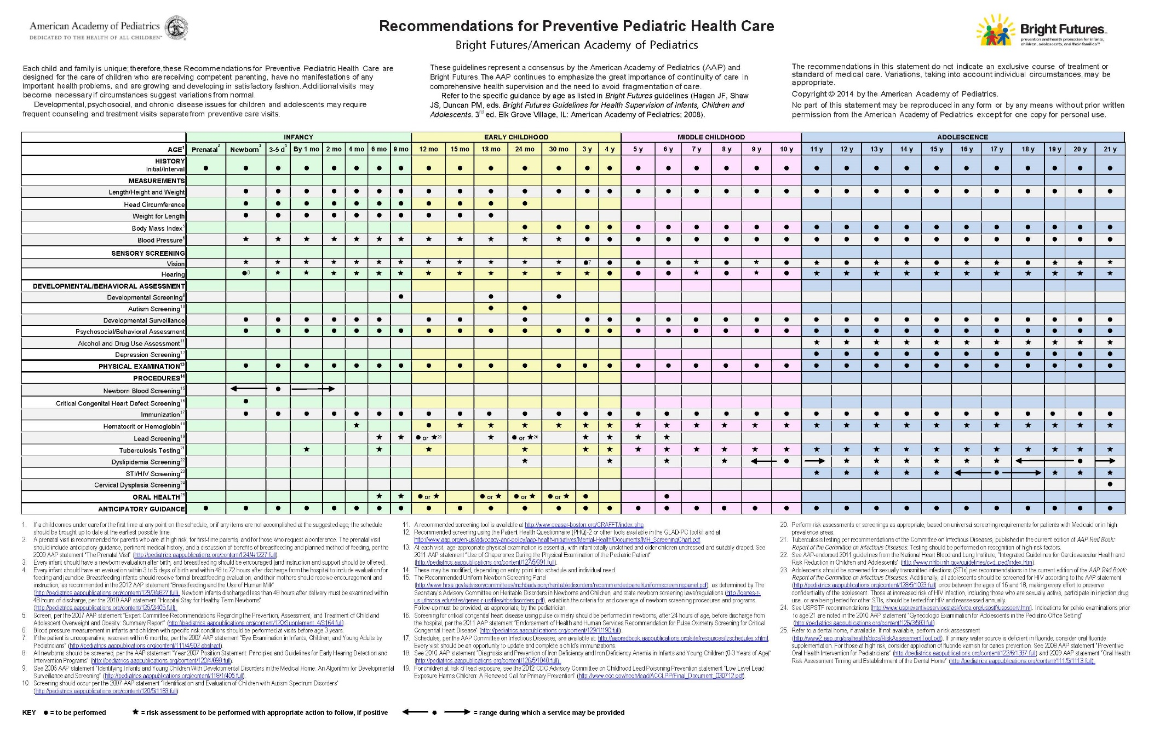
Bright Futures Periodicity Schedule

Slide 42
Periodicity Scheduled Updated March 2014
Summary of Changes Impacting Adolescents
Changes to Developmental/Behavioral Assessment
  Alcohol and Drug Use Assessment: Information regarding a recommended screening tool (CRAFFT) was added
  Depression: Screening for depression at ages 11 through 21 has been added, along with suggested screening tools
Changes to Procedures
  Dyslipidemia screening: An additional screening between 9 and 11 years of age has been added
  STI/HIV screening: A screen for HIV has been added between 16 and 18 years
  Cervical dysplasia: Adolescents should no longer be routinely screened for cervical dysplasia until age 21
For more information www.aap.org/en-us/professional-resources/practice-support/Pages/PeriodicitySchedule.aspx

Slide 43
Third Edition → Fourth Edition
Revision

Slide 44
Bright Futures Guidelines
4th Edition
Anticipated release: Late 2015
Public Review – Anticipated March 2015
Check Bright Futures Web Site brightfutures.aap.org
Email brightfutures@aap.org to sign up for newsletter/enews and you will be on the email list for the revision.

Slide 45
Revision Considerations
Review of Current Recommendations by Expert Panels
Identify existing related guidelines (e.g., USPSTF) and systematic reviews (e.g., Cochrane)
Evidence collection
  Including nomination by expert panels and Bright Futures Partners
Integration of new evidence
Transparency around Evidence Synthesis
  Recommendations & Rationale
Internal AAP/External Review Process

Slide 46

Web Site Resources
Updated Web Site Coming Soon: February 2015
brightfutures.aap.org/

Slide 47
Contact Information
American Academy of Pediatrics Bright Future National Center
Jane Bassewitz, MA
Manager, Bright Futures National Center
Phone: 847-434-7781
E-mail: brightfutures@aap.org
Web site: brightfutures.aap.org

Slide 48

What Pediatricians
say they are doing
% of Pediatricians who Report they Perform the
Preventive Service for All or Most Patients
(AAP Periodic Survey)
All Most
Complete age-appropriate risk assessments 50% 36%
Calculate BMI and plot on a growth curve 82% 11%
Discuss parental and child strengths 44% 33%
Use ‘Bright Futures Priorities for the Visit’ 27% 29%
Use MI/shared decisions 22% 33%
Screen sexually active youth for chlamydia 21% 24%
Not for citation or quotation without permission

Slide 49
What’s new in Guidelines?
Evidence-based recommendations for Young Adults, 18-25

Slide 50
Preventive Services for Young Adults
Based on a comprehensive review of existing guidelines, Ozer et al. found USPSTF and/or broad professional consensus for recommendations in the following areas:
  Substance Use
  Reproductive health
  Mental health/depression
  Nutrition/exercise/obesity
  Infection disease/immunization
  Safety/Violence
  Ozer et al., 2012
Notes:
In 2011 we undertook an analysis of existing guidelines of Adults developed by Professional Organizations and the US PSTF and found that there are recommendations – MISSING BUT THERE & WE CONTINUE TO UPDATE THEM ON OUR WEBSITE - NAHIC. WE WERE CONCERNED THAT PROVIDERS MAY NOT KNOW ABOUT THEM.

Slide 51
Evidence for Clinical Preventive Services for Adolescents and Young Adults
 | Adolescents | Young Adults
Substance use
Tobacco | Education and Counseling | Screening and Cessation Help
Alcohol | No evidence | Screening and Counseling
Reproductive Health
STI | Screening for sexually active and/or at-risk. Counseling for all sexually active. | Intense behavioral counseling for at-risk. HIV screening [everyone aged 15 to 65] Screening for syphilis [anyone at increased risk] Screening for Chlamydia and Gonorrhea [sexually active women age <24]
Cervical Cancer Screening | No evidence | Screen ≥21, every 3 years
Mental Health
Screen for Depression | Recommended when adequate systems in place | Recommended when adequate systems in place

Slide 52
Evidence for Clinical Preventive Services for Adolescents and Young Adults
 | Adolescents | Young Adults
Nutrition & Exercise
Obesity/BMI | Screening and referral | Screening and referral
Hypertension | No evidence | Recommended for those ≥18
Lipid Disorder | No evidence | Recommended for those ≥20 with increased risk for coronary artery disease
Immunization
Immunizations | Recommended by CDC | Recommended by CDC
Safety and Violence
Intimate partner violence | screen women of childbearing age | screen women of childbearing age

Slide 53
Vaccines for Adolescents and Young Adults:
A New Opportunity for Increasing Preventive Visits
Age | Flu | Tdap | HPV | Meningococcal | Other Vaccines
11-12 | X | X | X | X | by provider
13-18 | X | CU | CU, AR | CU, Booster | by provider
19-26 | X | AN | CU, AR | CU | by provider
X = Recommended vaccine
CU = catch-up vaccine
AN = On as needed basis
AR = For those at-risk
http://www.cdc.gov/vaccines/adults/rec-vac/index.html
http://www.cdc.gov/vaccines/schedules/easy-to-read/preteen-teen.html
http://www.cdc.gov/vaccines/schedules/downloads/adult/adult-schedule-easy-read.pdf
Notes:
With the addition of several new vaccines needing to be given during adolescence and the need for booster vaccines because of lack of effective immunity over time, the need for vaccines gives us a new opportunity for encouraging families, adolescents and young adults to get in for a preventive visit.
Also stay tuned to two new vaccines that have recently been approved by the FDA and will be considered by the Advisory Committee on Immunization Practice next month. These vaccines are specifically targeted to the Serotype B strain of Meningococcal Disease – the type that caused the Princeton and UCSB outbreak and a new HPV vaccine that will cover 9 serotypes compared with the current vaccine that only covers 4 types. These last two have specific relevance for the YA population.

Slide 54
What’s new in Guidelines - Tools
UCSF-NAHIC: Summary of Recommended Guidelines for Clinical Preventive Services for Young Adults ages 18-26
  http://nahic.ucsf.edu/yaguidelines/
The Partnership for Male Youth: Clinical Toolkit for Adolescent and Young Adult Males
  http://www.ayamalehealth.org/#sthash.boicPP5M.7O18oHOG.dpbs
Bright Futures: http://brightfutures.aap.org

Slide 55
Interventions to increase
Preventive Visit
Eliminate financial barriers
Health literacy
Training of Health Professionals
Immunizations
  School Mandates
  Increasing numbers of adolescent/young adult specific vaccines
Notes:
All AYA are able to have an annual preventive visit with NO COPAYS and the NO COPAYS APPLIES TO all evidence-based recommendations from BF and USPSTF that have been categorized as Effective at A and B
HEALTH LITERACY – Public Heath & Clinical Health needs to educate the public that they are eligible and no matter what type of insurance or coverage they have – the annual visit does not have a copay. Last week patient refused immunizations because in past copays were very high.
TRAINING – Often health professionals have not received the necessary training and may feel that it is a waste of time to intervene so they need the evidence-based information on what is effective and approaches to integrate into practice in a meaningful way –BF and we have developed a series of messages for various behaviors for clinicians to use in their office – CONDOM EXAMPLE, SMOKING EXAMPLE – NON SMOKNG.

Slide 56
Measures: Other Data Sources
Adolescents
  National Survey of Children’s Health
  National Health Interview Survey
  Medical Expenditure Panel Survey
  Centers for Medicare and Medicaid Services
Young Adults
  Behavioral Risk Factor Surveillance System
  Medical Expenditure Panel Survey
Notes:
CMS DATA FOR ADOLESCENTS INCLUDES YOUNG ADULTS THROUGH THEIR 21ST BIRTHDAY AND STAY TUNED FOR NEW MEASURES AS THEY DEVELOP.

Slide 57
Adolescent Surveys
Survey | Method | Response Rate | Respon-dent | PV definition | State-level Availability
NHIS | Face to face interview | 82% | Parent/ caregiver | “During the past 12 months, did ___ receive a well-child check-up, that is a general check-up, when [he/she] was not sick or injured?” Yes versus no. | Available for approximately half of states- largest states
NSCH | Phone interview | 38% land 16% cell | Parent/ caregiver | “During the past 12 months/Since [his/her] birth, how many times did ___ see a doctor, nurse, or other health care provider for preventive medical care such as a physical exam or well-child checkup??” Scored at least 1 vs none | Available for all states
MEPS | Face to face interview | 59% | Parent/ caregiver | Preventive visit measure constructed from respondent reports of health care visits ª (immunization visit, well-child visit, general checkup) (Recoded as at least 1 visit versus none) | Available for approximately half of states- largest states

Slide 58
Young Adult Surveys
Survey | Method | Response Rate | Respon-dent | PV definition | State-level availability
BRFSS | Phone interview | 53% land 28% cell | Young adult | “About how long has it been since you last visited a doctor for a routine checkup? A routine checkup is a general physical exam, not an exam for a specific injury, illness, or condition.” Within past year/or other. Yes v. no | Available for all states
MEPS | Face to face interview | 59% | Young adult OR Most know. Adult | “About how long has it been since (person) had a routine check-up by a doctor or other health professional?” Within past year/or other. Yes v. no | Available for approximately half of states- largest states
MEPS | Face to face interview | 59% | Young adult OR Most know. adult In house | Preventive visit measure constructed from respondent reports of health care visits ª (immunization visit, well-child visit, general checkup) (Recoded as at least 1 visit versus none) | Available for approximately half of states- largest states

Slide 59
AYA Receipt of PV Visit -2012
Adolescents: 50 to 88%
Young Adults: 26 to 58%
Notes:
SUPPORT OF FAMILIES, COMMUNITIES AND THE BROADER ENVIRONMENTAL CONTEXT HELP IN ACHIEVING GOOD OUTCOMES

Slide 60
CMS 2013 Preventive Care Measures:
Child and Adolescent Measures
Measure | # of states measuring
Adolescent Well Care Visit: Visit during measurement year (ages 12-21) | 43
Adolescent Immunizations Status: Age 13 during measurement year- had 1 meningococcal and 1 Tdap or Td vaccine by 13th birthday) | 32
Chlamydia Screening: Sexually active and had screening within measurement year (females ages 16-20) | 35
Child and Adolescent Access to Primary Care Practitioners: Visit within measurement- or prior- year (ages 12 months -19 years) | 43
Child and Adolescent Body Mass Index Assessment: Had outpatient visit and BMI percentile for age and gender is recorded (ages 3-17) | 27

Slide 61
CMS 2012 & 2013 Preventive Care Measure:
Adolescent Well Care Visit Rates
Measure | Rate: Average for 43 states
2013 Adolescent Well Care Visit | 44.8%
2012 Adolescent Well Care Visit | 44.4%
2012 Visits: 14/43 had rates of >50% (not available for 2013)
2012 Visits: 29/43 had rates of <50% (not available for 2013)

Slide 62
Consumer Resources:
A starter set
Young Invincibles: http://younginvincibles.org
Boston Children’s Hospital/Harvard University websites
  [www.YoungMensHealthsite.org]
  [www.youngwomenshealth.org]
Got transition: http://www.gottransition.org
Adolescent Health Working Group:
  http://www.ahwg.net
HHS: Office of Adolescent Health:
  http://www.hhs.gov/ash/oah/index.html

Slide 63
Introducing:
The Adolescent and Young Adult Health National Resource Center
Four-year cooperative agreement supported by MCHB (Sept 1, 2014 – August 30, 2018)
Purpose:
To improve adolescent and young adult health and address their health issues by strengthening the capacity of State Title V MCH Programs and their public health and clinical partners to better serve these populations (ages 10-25)

Slide 64
University of California San Francisco
Charles Irwin, Claire Brindis, Sally Adams, Jane Park
AYAH-NRC
University of Minnesota
Michael Resnick, Kristin Teipel, Glynis Shea, Rena Large
Adolescent & Young Adult Health – National Resource Center
Association of Maternal & Child Health Programs
Lacy Fehrenbach, Maritza Valenzuela, Treeby Brown
University of Vermont
Wendy Davis, Judith Shaw

Slide 65
ACCOUNTABILITY
TEAM
Co-Chairs:
Charles Irwin,
Maritza Valenzuela
Team:
Sally Adams, Jane Park
EQUITY TEAM
Co-Chairs:
Kristin Teipel,
Maritza Valenzuela
Team: Glynis Shea, Jane Park
ACCESS TEAM
Co-Chairs:
Judith Shaw, Charles Irwin
Team:
Claire Brindis, Jane Park, Maritza Valenzuela
QUALITY TEAM
Co-Chairs:
Wendy Davis, Lacy Fehrenbach
Team:
Treeby Brown, Jane Park, Maritza Valenzuela
Adolescent & Young Adult Health National Resource Center
INTEGRATION TEAM
Co-Chairs:
Claire Brindis, Kristin Teipel
Team:
Jane Park, Maritza Valenzuela

Slide 66
AYAH-NRC’s support for States
Collaborative Improvement and Innovation Network (CoIIN) to increase high-quality preventive services for AYAs
  CoIINs employ collaborative learning, quality improvement methods, and data-driven innovation to drive a national strategy and guide state implementation teams.
  State MCH programs, selected through an application process, partner with national experts to discover, identify and implement evidence-based strategies for increasing AYA access to well visits care and improving the quality of services.

Slide 67
AYAH-NRC’s support for States
Important CoIIN Dates
March 2015: Request for Applications will be released and distributed to state MCH programs.
March 12, 2015: Informational webinar (3:00pm EST) (Stay tuned for registration info).
April 2015: Applications due to AMCHP.
May 2015: Five states selected to participate in Cohort 1, and the work begins!
July 2015: CoIIN Summit for Cohort 1 states with training and accelerate collaborative learning.

Slide 68
AYAH-NRC’s support for States
Community-level Integration:
  Extending the CoIIN’s reach, the Center provides intensive support for integrating health care delivery and public health systems.
Data & Measures:
  Support state MCH programs adopting the adolescent well-visit National Performance Measure.
Best Practices:
  identify and disseminate up-to-date evidence-based practices(EPB) relevant to AYA health care and
  Support implementation EBP through training and technical assistance.

Slide 69
Small Groups
Choose 1 of these 4 groups Access for Adolescents Access for Young Adults | Quality for Adolescents Quality for Young Adults
In your small groups: 30 minutes
Briefly share experiences working on A or YA health?
What factors in your state support a focus on the well-visit? What factors are barriers to this focus?
What is one strategy that you would like to pursue?
What are the two most important things you need to take action on the well-visit (Information? Skills?)
Designate note-taker & person to report back (3 mins/group)

Slide 70
What support is available for other AYA Performance Measures?
PART IV

Slide 71
Support for performance measures in adolescent health population domain
By Resource Center
  AYAH-NRC
    Adolescent well-visit
  Children’s Safety Network
    Bullying
    Injury-related hospital admissions
  Strengthen Evidence Base for MCH Programs (JHU)
    Physical activity
Internal coordination among resource centers – no wrong portal
MCHB staff working in concert with the resource centers

Slide 72
References/Further Readings
Hagan JF, Shaw J, Duncan P. Bright Futures: Guidelines for Health Supervision of Infants, Children, and Adolescents. 2008. Available at http://brightfutures.aap.org/3rd_Edition_Guidelines_and_Pocket_Guide.html
Gore FM, Bloem PJN, Patton GC, Ferguson J, Joseph V, Coffey C, Sawyer SM, Mathers CD
Global burden of disease in young people aged 10–24 years: a systematic analysis. The Lancet. Published Online: 07 June 2011
Lau, JS, Adams SH, Park MJ, Boscardin WJ Irwin CE Jr Improvement in Preventive Care of Young Adults After the Affordable Care Act The Affordable Care Act Is Helping JAMA Pediatr. 2014;168(12):1101-1106.
Kirzinger WK, Cohen RA, Gindi RM. Trends in insurance coverage and source of private coverage among young adults aged 19–25: United States, 2008–2012. NCHS data brief, no 137. Hyattsville, MD: National Center for Health Statistics. 2013. http://www.cdc.gov/nchs/data/databriefs/db137.pdf
National Adolescent and Young Adult Health Information Center (2013). Summary of Recommended Guidelines for Clinical Preventive Services for Young Adults ages 18-26: Risk Factors and Recommended Screening Tests. San Francisco, CA: National Adolescent and Young Adult Health Information Center, University of California, San Francisco. Retrieved from http://nahic.ucsf.edu/cps/YAguidelines National Resource Council/Institute of Medicine.
Notes:
Not sure where the Trina source came from… http://www.civicenterprises.net/MediaLibrary/Docs/econ_value_opportunity_youth.pdf ?

Slide 73
References/Further Readings
National Research Council. (2014.) Investing in the Health and Well-Being of Young Adults:. Washington, DC: The National Academies Press.
National Research Council/Institute Medicine. (2008). Adolescent Health Services: Missing Opportunities. Washington, D.C.: The National Academies Press.
Ozer EM, Urquhart J, Park JM, Brindis CB, Irwin CE, Jr. Young adult guidelines: there but can't be found, Arch Pediatr Adolesc Med, 2012;49:476-482.
NAHIC is a resource center dedicated to adolescent and young adult health policy. For more information about the impact of the ACA on youth populations, please visit our website, including the new Resource Center Page at
http://nahic.ucsf.edu/resources/ACA
Notes:
Not sure where the Trina source came from… http://www.civicenterprises.net/MediaLibrary/Docs/econ_value_opportunity_youth.pdf ?

Slide 74
AYAH-National Resource Center
Contact Information
Jane Park, MPH
Telephone: 415-269-4272
Email: jane.park@ucsf.edu
AYAH-NRC website:
http://nahic.ucsf.edu/resources/resource_center/
NAHIC website: http://nahic.ucsf.edu/
Please visit our table! (#30)

