Slide 1

Adolescent and
Young Adult Health
National Resource Center:
A quick overview
May 9, 2017

Slide 2
Acknowledgements
Funder: Maternal and Child Health Bureau, Health Services and Resources Administration, USDHHS (cooperative agreement U45MC27709)
Project Officer: Trina M. Anglin, MD, PhD

Slide 3
The Adolescent & Young Adult Health National Resource Center
Purpose:
To improve adolescent and young adult health and address their health issues by strengthening the capacity of State Title V MCH Programs and their public health and clinical partners to better serve these populations (ages 10-25)
Four-year cooperative agreement supported by MCHB (2014 - 2018)

Slide 4





University of California
San Francisco
University of Minnesota
University of Vermont

Slide 5
The Adolescent and Young Adult Health National Resource Center
Major Activities:
YOU! The Collaborative Improvement and Innovation Network:
Technical assistance to states that selected NPM #10, including:
  Phone consultation, webinars and virtual “office hours” for selected topics
  Development of Tools and Resources
http://nahic.ucsf.edu/resources/resource_center/

Slide 6
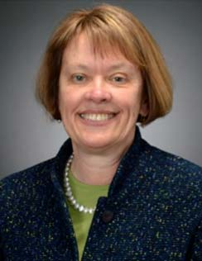
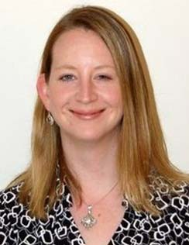
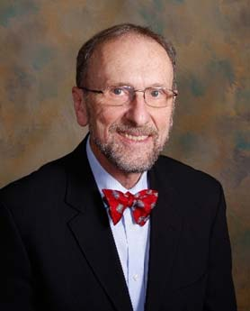
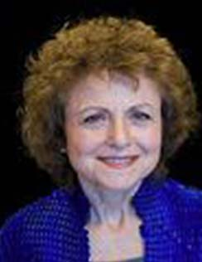
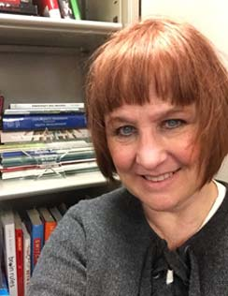
Center Leadership
Co-Project Directors
Project Director
Wendy Davis, MD
UVt/NIPN
Caroline Stampfel, MPH
AMCHP
Charles E. Irwin, Jr., MD
UCSF
Claire Brindis, DrPH
UCSF, NAHIC
Kristin Teipel, MPH, BSN
UMn/SAHRC

Slide 7
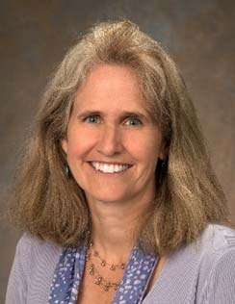
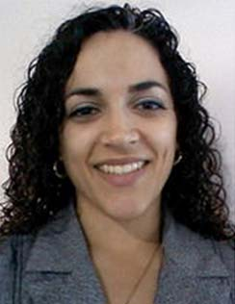
Center Coordination
Jane Park, MPH
Project Coordinator
UCSF, NAHIC
Iliana White, MPH, CHES, CPH
CoIIN Coordinator
AMCHP
Kristin Teipel, MPH, BSN
General TA Coordinator
UMn/SAHRC

Slide 8
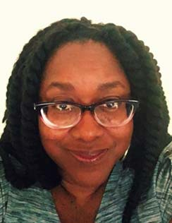
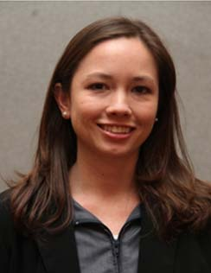
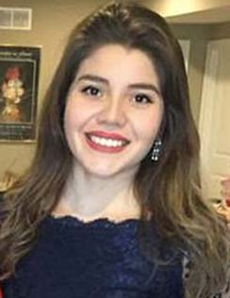
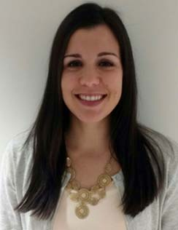
More Center Staff: AMCHP
Cheryl Clark, DrPH, RHIA
AYAH CoIIN Data Team
AMCHP
Kate Taft, MPH
CoIIN State Liaison
AMCHP
Kelly Umaña
AYAH CoIIN Program Associate
AMCHP
Anna Watson, MPH, CPH
AYAH CoIIN Program Analyst AMCHP

Slide 9
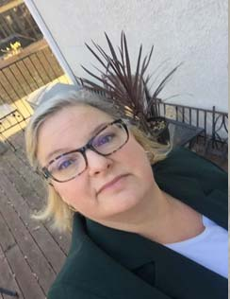
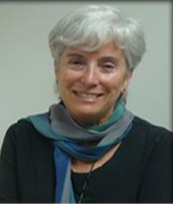
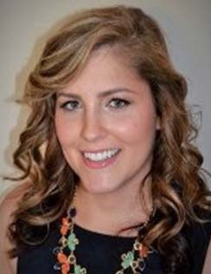
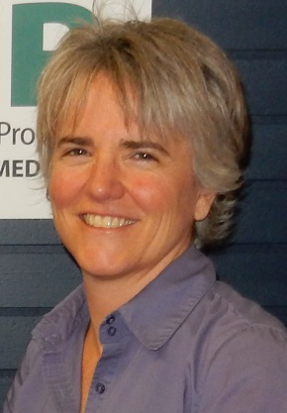
More Center Staff
SAHRC/UMn & NAHIC/UCSF
  Glynis Shea
  AYAH Center Communications
  and Equity Lead
  SAHRC/U Mn
Sally Adams, PhD, RN
AYAH-CoIIN Data Team
AYAH Center Research Lead
UCSF
Lauren Twietmeyer, MPH
AYAH Center/CoIIN Research Associate
UCSF
  Rachel Wallace-Brodeur
  QI Specialist
  UVM/NIPN
Notes:
After for slide 10: coiin 1 people (list, correct dr. ms..)); slide 11: advisory board; slide 12: additional AMCHP staff (hannah, etc.)

Slide 10
CoIIN 1 Participants
NAME | POSITION | STATE
Marcus Johnson-Miller | Title V Director | Iowa
Addie Rasmusson | Adolescent Health Coordinator | Iowa
Tessa Medina-Lucero | Adolescent Health Coordinator | New Mexico
Xavier Barraza | Youth Advocate | New Mexico
Michelle Maseroni | Youth Advocate | Vermont
Alyssa Consigli | Project Director, VCHIP | Vermont

Slide 11
AYAH Advisory Board
NAME | ORGANIZATION
Erin Hemlin | Young Invinbles
Peggy McManus | The National Alliance to Advance Adolescent Health
McKane Sharff | Johns Hopkins University
Serina Kavanaugh | DC Department of Health Care Finance
Abigail English | Center for Adolescent Health & The Law

Slide 12
Additional AMCHP Staff
Paige Bussanich
Kristen Taylor
Hannah Borrowsky

Slide 13
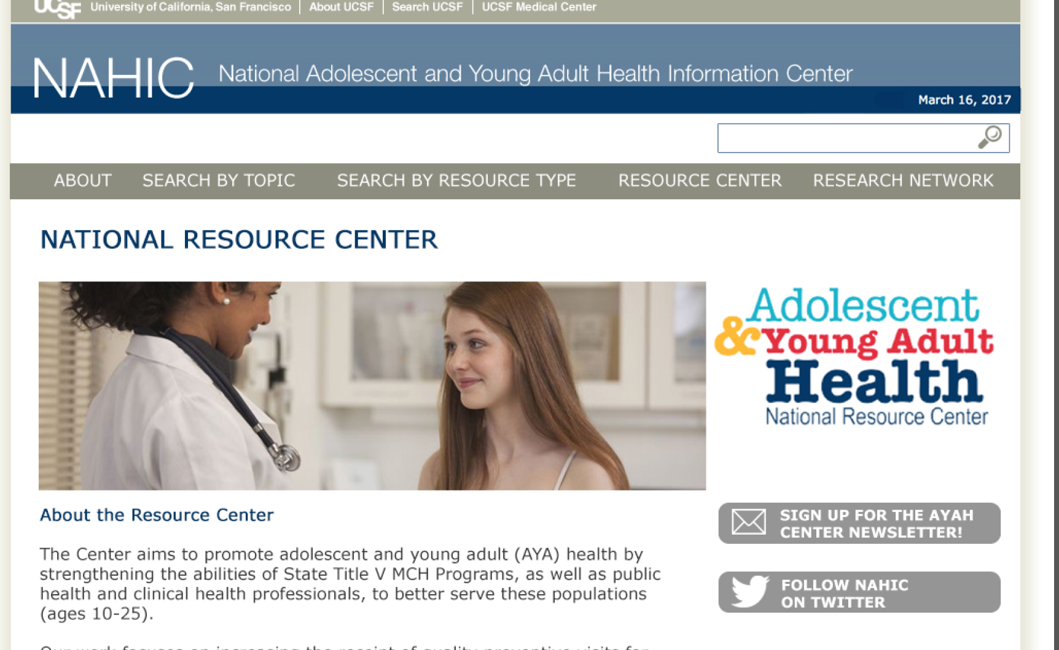
For information & resources: visit our new website http://nahic.ucsf.edu/resource-center/

Slide 14
More good ways to stay connected and informed!
(more tomorrow…)
Visit SharePoint
Read the CoIIN list-serv

