Slide 1
Adolescent/Young Adult Centered Care
Three interventions in California to improve health care for AYAs (brief review)
Charles E. Irwin, Jr., MD, UCSF
Project Director, AYAH-NRC
Michigan’s Adolescent Health Initiative
Maggie Riley, MD & Lauren Ranalli, MPH,
University of Michigan

Slide 2
Improving Access/Quality AYAH
Health Plan Intervention in Northern California – Kaiser – Permanente
Medicaid-Managed Care in California
Plumas County Public Health Intervention

Slide 3
Kaiser Permanente Program
Program Setting:
1/3 of insured adolescents in Northern CA were enrolled in Kaiser
2.5 average visits/year
Usual source of care ER/Urgent Care
Program Goal: Improve Quality of Care
Focus on Kaiser’s entire Pediatric System
Program Outcomes:
More adolescents screened & counseled across six risk areas
Increase in healthy behaviors and decrease in unhealthy behaviors

Slide 4
Medicaid Managed Care in California
29% of adolescents in CA are enrolled in Medicaid
Less than half of adolescents accessing well visits
Statewide initiative
1-day training at three sites for clinicians & managers
Screening tools & evidence-based recommendations
Roll out in practices with weekly phone TA for 3 months
Increased receipt of well visits
Source: California Health Interview Survey , 2013

Slide 5
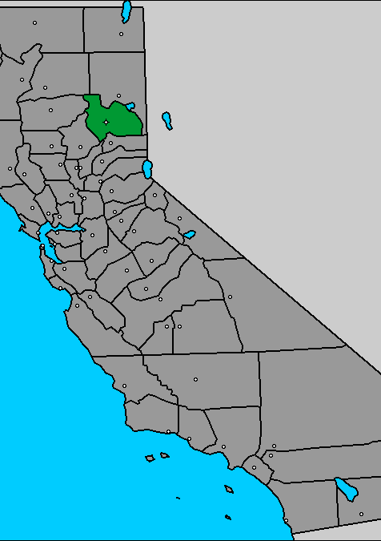
Plumas County
Rural county
Unemployment > 20%
High rates of adolescent pregnancy
Primary Care:
1 Pediatrician
7 FP docs & 1 NP
1 Mental Health provider
Strong public health leadership
Notes:
http://www.city-data.com/county/Plumas_County-CA.html
8 people per square mile
2012 population: 19,399
Land area 2,554 square miles
http://www.plumascounty.us/index.aspx?nid=190
Population: slightly over 20,000
http://www.cdc.gov/nchs/data/series/sr_02/sr02_166.pdf
Plumas county= Defined as Rural

Slide 6
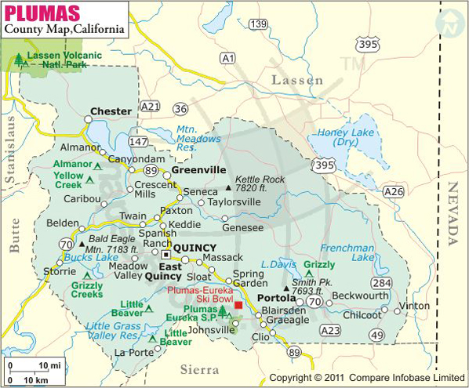
Plumas County (Pop. 20,000)

Slide 7
Plumas County
Nonprofit Foundation linked County to UCSF
Consultation & TA: Interdisciplinary UCSF Team
Public Health: Integration of family planning & preventive care
Family Doctors & Nurse Practitioners:
Plan B: Contraceptive “workaround”
Black Box Fear: Depression screening and pharmacotherapy
Schools: Teachers & Students
Families

Slide 8
Coming Up…
AYAH-NRC Webinar
on young adult initiative
at Kaiser Northern California

