Slide 1
Improving Adolescent and Young Adult Clinical Practice
A Quality Improvement Approach
Wendy S. Davis, MD FAAP
Associate Director, National Improvement Partnership Network
September 24, 2015

Slide 2
Session Objectives
Identify similarities between applying quality improvement (QI) methods in public health and health care delivery settings
Describe examples of clinical practice-based projects designed to improve AYA healthcare access & quality
Consider AYAH measures that may be used in your project(s)
Review your state team’s proposed project:
Is it feasible?
Do you have a “SMART” aim?
Do you wish to modify your project plan?

Slide 3
QI Principles
Incremental change
Data-driven
Environment for shared learning
Team Work and Communication
Systems and Processes
Individual and population health outcomes
Sustainability
Notes:
QI principles are the same whether applied in public health or clinical care settings
REVIEW

Slide 4
Understand the Process FIRST
Identify the team
Talk to stakeholders
Understand the underlying system
Map out the current process
Identify the problem (gap)
Identify a change that fits the problem

Slide 5
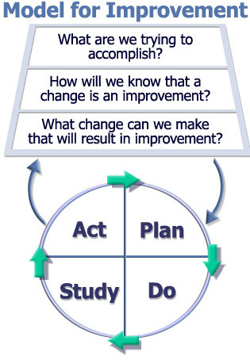
QI: The Model for Improvement
Aim
Measurement
Change
From The Improvement Guide
Langley, Nolan, Nolan, Norman and Provost
Notes:
We’ve presented the “Model for Improvement”
Aim: stating as clearly as possible with a SMART framework exactly what it is that you are trying to accomplish
To determine a measurement plan – I’m going to talk about some measures
And then to identify and test strategies for change that you think will lead to the improvement you are seeking.

Slide 6
Defining Quality Improvement
Quality improvement in public health:
Use of a deliberate and defined process (e.g., Plan-Do-Study-Act)
Focused on activities designed to respond to community needs and improve population health
Continuous & ongoing effort to achieve measurable improvements in efficiency, effectiveness, performance, accountability, outcomes, & other indicators of quality services or processes.
Goal: achieve equity & improve health of the community
(Source: Riley et al. Defining Quality Improvement in Public Health. JPHMP. 2010;16(10): 5-6.)

Slide 8
Improvement Partnerships
What: State or regional quality improvement (QI) organizations focused on maternal and child health (MCH) and primary care practice
Bring partners together from across MCH systems
Lead & coordinate QI projects in child-serving settings
Where/Who: academic institution (medical school), children’s hospital, state govt. department/office (DOH, Medicaid), AAP/AAFP chapter, QI organization
Why: “Honest broker” to provide access (for states, systems) to clinical practices; engage clinicians in public health aims
Notes:
WHAT:
PARTNERS: some common and some different benefits for different stakeholders:
Especially for health care professionals, IPs can support practices/clinicians in meeting regulatory and certification requirements (e.g., PCMH, MOC, CME)
WHY: serve as convener and “honest broker” for interested organizations and entities; engage reluctant stakeholders
Spread successful approaches statewide
Serve as a resource for improvement assistance
Translate knowledge through engagement of national and local experts
Disseminate findings, spreading successful approaches and informing policy

Slide 9
What do Improvement Partnerships do?
Develop and test tools, measures, and strategies
Serve as a resource for improvement assistance
Translate knowledge through engagement of national and local experts
Disseminate findings, spreading successful approaches and informing policy
Provide opportunities for health care professionals to obtain CME and/or fulfill specialty board (MOC) requirements
Inform policy

Slide 10
Mission to optimize the health of Vermont children by initiating and supporting measurement-based efforts to enhance private and public child health practice. In partnership with: Vermont Department of Health University of Vermont Depts. of Pediatrics, Family Medicine, OB, Psychiatry Vermont Chapter of the American Academy of Pediatrics Vermont Chapter of the American Academy of Family Physicians Department of Vermont Health Access (Medicaid) Vermont Agency of Human Services Insurers, Managed Care Organizations

Slide 11
Clinical Practice-Based Improvement
Measures (re-measures)
provision of care and
outcomes
Dramatically improved levels of performance
Feeds results back to practices
and shows comparison to other
sites’ performance.
Facilitates shared learning among
practices through collaborative
meetings & conference calls
Provide topic-specific
improvement materials and tools
Coaches practices in
choosing improvement goals
and implementing change

Slide 12
VCHIP: Youth Health Improvement Initiative (YHII)
Mission: To improve the health outcomes of school-aged children and youth through high quality primary health care in Vermont
Stakeholders: health dept., Medicaid agency, payers
Target audience: all VT youth-serving PCPs (70+ pediatric & family medicine practices), school nurses
Impact: PCPS offer high quality (Bright Futures) adolescent well care visits
Strength/risk assessment and brief intervention or referral for risks
Special attention to HEDIS measures for Adolescent Well Care

Slide 13
Accomplishments
Enhanced communication among PCPs and Insurers, Community Partners, School Nurses
Introduce standardized forms that encourage a complete Bright Futures Adolescent Well Exam instead of just a “sports physical”
Collaborated w/insurers to improve adolescent health care delivery/measures (HEDIS)
% of youth seen for annual Adolescent Well Exams
% of youth screened for Chlamydia, etc.)

Slide 14
Promotion of Comprehensive Well Exam for Sports Participation

Slide 15
Accomplishments (cont’d.)
Coaching PCPs to incorporate screening for strengths and risks into Adolescent Well Care
Development of parent information sheets on Adolescent Well Visits and Confidentiality; sent to all pediatricians, family physicians, school nurses
Toolkit: Promoting Healthier Weight in Pediatrics

Slide 16
Results: Improving Adolescent HEDIS Measures through MOC QI

Slide 17
Lessons Learned
Offer flexible formats: learning collaboratives, in-office academic detailing, MOC Part 4 credit
Partnerships are critical: develop buy-in (improving outcomes benefits all!)
Ask youth and parents what they want from a Well Exam – then educate PCPs/partners
Always use a STRENGTH-BASED approach!

Slide 18
Future Plans
Many VT PCPs ready to offer excellent Adolescent Well Visits, but most adolescents are NOT accessing . . .
Work with partners (school nurses, insurers) who can get the word out to parents and youth
Continue to support PCPs to increase their skills in addressing adolescent risks (obesity, depression, contraception) & building adolescent strengths
Spread the word that building adolescent strengths can help mitigate the effects of ACEs

Slide 19
Vermont AYAH CoIIN Team
Public Health
Improvement Partnership (VCHIP)
AAP / AAFP
Private Insurers
Medicaid
GOAL: Improve access & quality of adolescent well visits in 5 pediatric/family practices
Focus groups to identify local barriers
QI coaching
+ | ❐
Engaged AAP / VAFP Chapter Engagement between education and public health at state & local Bright Futures Strong QI infrastructure Good relationship with Medicaid and private insurers Data: School RN report & YRBS | Misunderstanding by schools, families, students (well visits vs. sports clearance) Provider capacity System infrastructure Provider comfort with adolescents Data: NSCH, HEDIS, CMS416
Notes:
Statewide:
Strengths
Engaged chapters of AAP/VAFP
Local level engagement of schools with public health
Promote Bright Futures guidelines (EPSDT periodicity schedule)
Strong QI infrastructure
Strong relationships with education leadership
Good relationships with Medicaid and private insurers
Getting to ‘Y’
Barriers
Misunderstandings (the what? the benefits?) by schools, families, students:
Well exams vs. sports clearance, acute injury/illness and IZ visits
Confidentiality
Provider
Provider capacity at local level
Systems infrastructure (recall-reminder, pre-visit questionnaire)
Comfort with adolescence (how to talk about tough issues, what if they screen positive)
H
Data
+ school nurse report, YRBS
- HEDIS, CMS416, NSCH

Slide 20
Session Objectives
Identify similarities between applying quality improvement (QI) methods in public health and health care delivery settings
Describe examples of clinical practice-based projects designed to improve AYA healthcare access & quality
Consider AYAH measures that may be used in your project(s)
Review your state team’s proposed project:
Is it feasible?
Do you have a “SMART” aim?
Do you wish to modify your project plan?

Slide 21
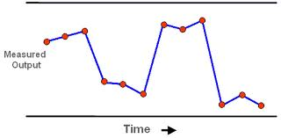
Measurement
How you will know when you’ve accomplished your aim
Measuring for improvement: different from project/program measurement
Short cycles
“Just enough” data
Learning vs. Judgment/Accountability
Failure is good!
Quick turnaround
Run charts – view data over time

Slide 22
Adolescent &Young Adult Health Measures
Notes:
Quick description of NIPN as umbrella organization for IPs

Slide 23
Acknowledgements
Barbara Frankowski, MD, MPH and Alexandra Highet at the National Improvement Partnership Network (NIPN), University of Vermont
Jane McGrath, MD, Director of Envision New Mexico and Medical Director of the University of New Mexico School-Based Health Center
Charles Irwin, MD, Director of the Adolescent and Young Adult Health National Resource Center (AYAH-NRC) and of the National Adolescent Health Information Center (NAHIC) at the University of California, San Francisco
Sally Adams, PhD, RN, Data Coordinator and Analyst of NAHIC
M. Jane Park, MPH, Project Coordinator of NAHIC

Slide 24
Background
Goal: strengthen reporting of Improvement Partnership outcomes by establishing sets of standard measures
Asthma
Healthy Weight
Adolescent and Young Adult Health Measures
Guide practice-based efforts to provide comprehensive, high-quality preventive services (Bright Futures) visits
Guide efforts to improve population health

Slide 25
AYAH Measures
What they ARE
What they ARE NOT
Standard, clearly defined measures that are recommended for preventive services visits for AYA
Meant to be modified and added to, as new evidence becomes available
A comprehensive list of everything that could happen in the context of a preventive services visit for AYA
Guidelines that dictate how to perform a preventive services visit for AYA
Notes:
Provide examples (ie difference between 12 vs. 21 yr with risk for chlamydia testing)

Slide 26
Measure Development
Crosswalk:
Bright Futures 3rd Edition (plus the updated Periodicity Schedule) used as the “gold standard” up to age 21
ACOG guidelines used for older females
Clear guidelines for young men aged 21-26 does not seem to exist
Measure Stewards (e.g., HEDIS, CHIPRA, MCHB for National Performance Measures): variability in definitions, age/gender.
Few with rigorous evidence review processes (by USPSTF or NHLBI)
Age 11 was chosen as the lower age to correspond with Bright Futures grouping of young adolescents. Depending on patient population and measure selected, some may wish to use 9 or 10.
Age 25 (up until the 26th birthday) was chosen as the upper age to correspond with AYAH National Resource Center definition.
Notes:
To develop these AYAH Measures, a crosswalk of pediatric and young adult measures was constructed, and AYA-specific measures endorsed by a national measure steward were identified. While recommendations and guidelines from multiple national institutes were synthesized, Bright Futures 3rd Edition (plus the updated Periodicity Schedule) was used as the “gold standard” up to age 21 and ACOG guidelines for older females.
Age: We chose 11 as the lower age to match with Bright Futures grouping of young adolescents. Depending on patient population and measure selected, some may wish to use 9 or 10. We selected 25 (up until the 26th birthday) to match with AYAH Resource Center definition.
Clear standardized guidelines for young men aged 21-26 does not seem to exist.

Slide 27
Sample Strategies
Select Measures Define Numerator and Denominator Set Target Goal
Improvement Partnership Perspective
Public Health Perspective
Select measures that are important to AYA health at regional or state level
Select measures of interest to key stakeholders (MCH, Medicaid)
Use claims data or state registries (vs. chart review)
Define denominator as broadly as possible (“all AYAs 11-25 covered by Medicaid”)
Set target goal
Select measures that are important to practices and their patient population
Consider using Institute for Healthcare Improvement Breakthrough Series methodology: pre and post chart reviews, with at least 2 interval samplings to mark progress
Use American Board of Pediatrics (ABP) guidelines for sampling if the improvement is part of MOC Part 4 project
Define denominator as AYAs who have had preventive services during the measurement period
Set target goal
Notes:
Selecting measures
Define denominator
Set Target Goal

Slide 28
AYAH Measures Categories
Preventive Services
Patient Engagement
Nutrition, Physical Activity and Cardiovascular Risks
Safety / Violence
Sexual Health
Substance Use
Mental Health
Immunizations

Slide 29
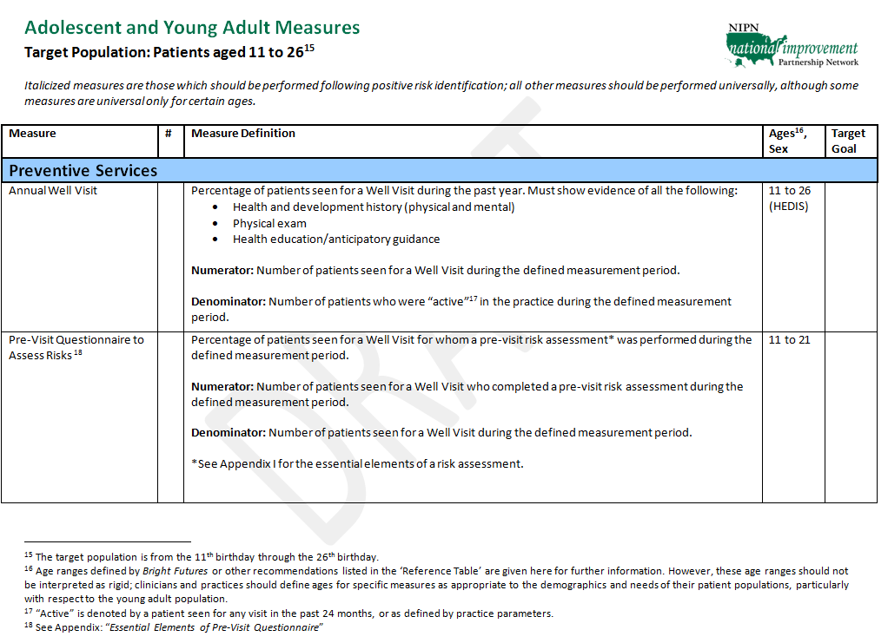
AYAH Measures Format

Slide 30
Preventive Services
Standard components of health supervision visits
Some recommended universally, at every age (e.g., BP, BMI)
Some recommended universally, at selected ages (hearing, vision)
Some denote the test to be performed if risk factors identified
Consider using pre-vist questionnaire (e.g., Bright Futures) to identify risks that trigger action (tests)
Appendix I: essential elements to be included in pre-visit questionnaire
Preventive Services
1 | Annual Well Visit
2 | Pre-Visit Questionnaire to Assess Risks
3 | Physical Exam
4 | Weight Assessment/Body Mass Index (BMI) Percentile
5 | Blood Pressure and/or Blood Pressure Percentile
6 | Vision Testing (Snellen Test)
7 | Hearing Testing (Audiometry)
8 | Anemia Test
9 | Tuberculosis Test
10 | Dental Home Verification

Slide 31
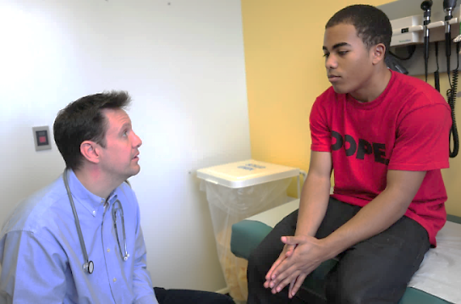
Patient Engagement
Patient Engagement, though not always documented and difficult to measure, is the “heart” of the high-quality preventive visit
Trusting relationship is built
Strengths-based approach is used
Stage is set to address and mitigate identified behavioral risks through shared decision making and goal setting
Appendix I includes elements that address patient strengths. For those less familiar with strengths, Appendix II illustrates one framework for assessing strengths. Refer to Bright Futures for a more detailed discussion.
Patient Engagement
11 | Confidentiality Policy Reviewed with Parent and Patient
12 | Private Time with Patient During Visit
13 | Pre-Visit Questionnaire to Assess Strengths
14 | Patient (Parent) Strengths Discussed
15 | Patient (Parent) Concerns Actively Elicited
16 | Patient (Parent) Concerns Addressed
Notes:
Patient Engagement, though not often documented and difficult to measure, is the “heart” of the high-quality preventive visit. Through these components, a trustworthy relationship is built between the provider and patient, the AYA is encouraged to speak openly and honestly about their health, and the stage is set to address and mitigate identified behavioral risks. The strengths-based approach to preventive care and anticipatory guidance is endorsed by Bright Futures. Ongoing research shows that identifying and building strengths can ameliorate risk-taking and unhealthy behaviors, and also helps to address social determinants of health.
For those less familiar with strengths, Appendix II illustrates one framework for assessing strengths. Refer to Bright Futures for a more detailed discussion.

Slide 32
Nutrition, Physical Activity and Cardiovascular Risks
Measures that apply universally, as well as additional steps to be taken for patients with identified risk factors such as elevated BMI.
Nutrition, Physical Activity and Cardiovascular Risks
17 | Universal Lipid Screening
18 | Counseling for Nutrition
19 | Counseling for Physical Activity
20 | Lipid Disorder Screening
21 | Readiness to Change
22 | Self-management Goal

Slide 33
Safety/Violence
Key behavioral health indicators, endorsed by Bright Futures
Seven elements (not a comprehensive list); may vary due to local or regional demographics and policies.
Safety and Violence
23 | Family/Partner Violence
24 | Fighting
25 | Helmets
26 | Seat Belts
27 | Alcohol while Driving
28 | Guns
29 | Bullying

Slide 34
Sexual Health & Substance Use
Universal for all age groups/genders (e.g., alcohol and tobacco use screening)
Universal for certain age groups (HIV Screening) or genders (Cervical Cancer Screening)
Some measures are performed if certain risks are positive.
Measures that address initial follow-up for some behaviors (e.g., Smoking Cessation Counseling), where evidence exists
Substance Use
40 | Alcohol Use Screening
41 | Tobacco Use Screening
42 | Medical Assistance with Smoking and Tobacco Use Cessation
43 | Initiation/Engagement of Alcohol and Other Drug (AOD) Dependence Treatment
44 | Other Illicit Drug Use Screening
45 | Counseling for Other Illicit Drug Use
Sexual Health
30 | HIV Screening
31 | STI Screening
32 | Chlamydia Screening
33 | Gonorrhea Screening
34 | HIV Screening
35 | Syphilis Screening
36 | STI Counseling
37 | UPT/Pregnancy Test
38 | Birth Control Methods
39 | Cervical Cancer Screening
Notes:
Sexual Health and Substance Use measures address some of the behaviors and choices that impact immediate morbidity and mortality for the AYA population, as well as adult health outcomes. These aspects of the patient’s wellbeing should be identified and screened, and modified through counseling and strategies where appropriate. Measures are included that address initial follow-up for some of these behaviors (such as STI Counseling), where evidence exists for such action.

Slide 35
Mental Health
Evidence-based measures that document screening and initial intervention for depression.
Universal screening for depression across the age range has USPSTF Grade B evidence (when systems are in place to assure accurate diagnosis, effective treatment, and follow-up)
Suicide Screening is recommended by Bright Futures but USPSTF found Insufficient evidence.
Awaiting final recommendations in Bright Futures 4th Edition
Other mental health issues are currently beyond the scope of this document.
Mental Health
46 | Screening for Clinical Depression
47 | Intervention or Follow-Up for Clinical Depression
48 | Suicide Screening

Slide 36
Immunizations
Review patient vaccination status at every visit to the provider office
Recommended denominator for these measures is broader
Immunization recommendations are constantly evolving (e.g., Serogroup B Meningococcal vaccine) - consult the Advisory Committee for Immunization Practices (ACIP) for up-to-date recommendations.
Measures as written focus on completion of each vaccine series (e.g., 3-dose series for Human Papillomavirus vaccine), but providers may wish to measure initiation of a vaccine series.
Notes:
Every visit
New IZ – REVIEW ACIP
Use as your target initation or completion of series IZ

Slide 37
Reference Table
Crosswalk of relevant guidelines, evidence reviews and recommendations, measure stewards, federal mandates and supportive information for each measure.
Can be used to choose which measures you may want to work on with particular stakeholders
Not an exhaustive list; may change over time

Slide 38
Emerging Issues
Transition from Pediatric to Adult Care
Children/Youth with Special Health Care Needs
Young Adult Male Health Guidelines
Transgender AYA Health Guidelines
Insurance status
Others?

Slide 39
AYAH Measures: Future Plans
“Finalize,” post on NIPN web site
We welcome your feedback
Content? Organization?
Missing Measures?
Usefulness?
Pilot Measure Use
Assistance to those who wish to conduct pilot
Feedback from those who use measures in the context of a quality improvement project
www.nipn.org

Slide 40
Session Objectives
Identify similarities between applying quality improvement (QI) methods in public health and health care delivery settings
Describe examples of clinical practice-based projects designed to improve AYA healthcare access & quality
Consider AYAH measures that may be used in your project(s)
Review your state team’s proposed project:
Is it feasible?
Do you have a “SMART” aim?
Do you wish to modify your project plan?

Slide 41
QUESTIONS/DISCUSSION

