Slide 1
Strengthening Systems & Partnerships
Holly Tutko, MS
Kristin Teipel, MPH
Rachel Wallace-Brodeur, MS, MEd

Slide 2
Phone #: (866) 865-2157 Conference Code: 867-002-3759
Phone #: (866) 865-2157 Conference Code: 867-002-3759
PARTNERSHIPS to strengthen SYSTEMS

Slide 3
Phone #: (866) 865-2157 Conference Code: 867-002-3759
Phone #: (866) 865-2157 Conference Code: 867-002-3759
Managing partnerships…
Easy as herding cats

Slide 4
Phone #: (866) 865-2157 Conference Code: 867-002-3759
Phone #: (866) 865-2157 Conference Code: 867-002-3759
Get to know each other (relationships matter)
Link, bridge, align efforts
Partner with enthusiastic people
Work with enthusiastic people
Get buy-in early
Help others working on similar issues
Help partners do what they do best
Find common ground
Tap existing networks
Share ownership & credit
Focus on areas of passion
Keep it simple
Create clear roles, responsibilities
Invest in managing partnership
Connect with partner needs/interests
Start with quick wins
Measure & share progress, accomplishments
SUCCESSFUL Partnerships

Slide 5
Benefits of Partnerships
Coordinate improvement efforts
Reduce redundancy
Facilitates spread of improvement
Creates linkages between stakeholders and draw on varied expertise
Innovation

Slide 6
Identifying Partners
Organizations that are active in AYA health
State Agencies (Health, Education, Medicaid)
Local professional organizations (AAP, AAFP)
Health care professional & organizations
Improvement Partnerships/QI Organizations
Academic Institutions
Insurers & other health care payers
Policy makers
Patient/Family organizations
AYA advocacy groups

Slide 7
Potential Partners, Interests & Contributions

Slide 8
State Government Perspective
Collaboration increases delivery system efficiency & effectiveness; decreases cost
Accountability – value for public funds
Focus on underserved populations
Coordination of services
Improved outcomes for citizens – link to state results and priorities

Slide 9
Practitioner Perspective
Want to improve care delivery but lack time, expertise, resources
Want to coordinate care and reduce redundancies
Need to meet certification requirements
Need to respond to regulatory/ reimbursement mandates
Notes:
Want to partner with community organizations to reduce redundancies
Need tools, materials, curricula, methodology
Certification req: MOC/CME
Reg/reimbursement mandages: PCMH, HIT, meaningful use,

Slide 10
Insurer Perspective
Quality healthcare and service
Disseminate, implement standards
Improve measures (HEDIS, CHIPRA)
Cost-effective and cost-efficient

Slide 11
Lessons Learned from NIPN*
Identify common ground among all stake holders
Get buy-in from opinion leaders early
Share ownership & credit
Use success stories from other regions to promote the idea
* National Improvement Partnership Network
Notes:
Convene interested stakeholders to align priorities, find solutions for common problems
Maintain relevance for all stakeholders
Find and engage clinicians as willing partners
Link to professional organizations (e.g., primary care)
Public-private collaborations impact care and outcomes as no single entity can

Slide 12
http://www.med.uvm.edu/nipn/resources

Slide 13
Phone #: (866) 865-2157 Conference Code: 867-002-3759
Phone #: (866) 865-2157 Conference Code: 867-002-3759
Insights & Lessons Learned:
New Hampshire Pediatric Improvement Partnership
https://www.nhpip.org/

Slide 14
Stakeholder Engagement: the NH Experience
May 3, 2017

Slide 15
Agenda
Introduce NH Pediatric Improvement Partnership
Our story: engaging partners to improve pediatric care quality
Offer some tips to help you enact stakeholder engagement strategies

Slide 16
Pediatric improvement partnership is….
a durable, regional collaboration of public and private partners that uses measurement-based efforts and a systems approach to improve the quality of children’s health care
Definition Credit: National Improvement Partnership Network
Notes:
Geez these words sound a lot like those used by AYAH CoIIN
Maryland, Minnesota, Washington, Wyoming, New Jersey, New Hampshire

Slide 17
What Do Improvement Partnerships Do?
Develop and test QI tools, measures, and strategies
Serve as a resource for improvement assistance
Translate knowledge through engagement of national and local experts
Disseminate findings, spreading successful approaches and informing policy
Serve as convener, an “honest broker”
Credit: National Improvement Partnership Network
Notes:
You can read these, but what I hope to convey is that the functions that PIPs serve fit nicely into the goals of the AYAH CoIIN efforts and for us in NH provide an existing vehicle to engage in this project, but ideally have this project serve as a springboard for taking a more comprehensive look at how are we doing with respect to adolescent and young adult health, particularly as our state does not currently have an adolescent health coordinator.

Slide 18
NH Pediatric Improvement Partnership
Partners
UNH
NH Pediatric Society
NH Academy of Family Physicians
NH DHHS (Medicaid, MCH, Special Medical Svcs)
Geisel School of Medicine @ Dartmouth
Children’s Hospital @ Dartmouth
Pediatric Practices
Family Medicine Practices
NH Medicaid MCOs, Dept. of Insurance & commercial insurers
NH Family Voices
Governor’s Advisory Council on Early Childhood

Slide 19
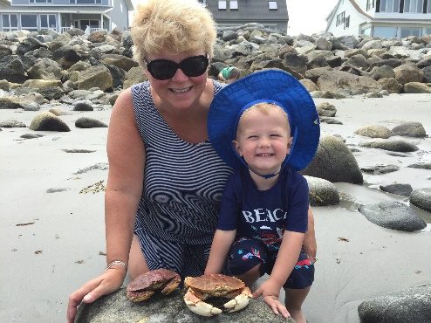
Perspective Sharing of Team…
Sue Vermette
Quality Manager
Wellsense Health Plan
Venue to engage with diverse stakeholders
Stay current on state pediatric care/policy context
Learn best/promising practices to share with practices.
Place to bring challenges and seek guidance.
Bring attention to HEDIS measures and Medicaid population
Notes:
Engagement: provides a space for us to get to know other providers, systems that are also working on pediatric interests (state MCH, Academia, etc) Form relationships, where are collective interests area

Slide 20
Building Engagement
Use existing Networks
Build on existing relationships
Notes:
Build on existing networks – especially ones that have proven track record of action!!!!! These are the ones partners will take the time to be involved in.
Example from NH -- NH Citizens Health Initiative.
Multi-stakeholder state health improvement effort run by UNH. NH CHI has a great track record of serving as “the place” where collaborative discussion of payers, providers, state agencies (including Medicaid) participate. IHPP UNH IHPP also has track record of working with NH Medicaid on data-related projects and other things. I worked and continue to work for NHCHI work. I had these relationships and the director of the NHCHI also had relationships with payers, providers to help open the door to these organizations (such as insurers). These organizations have kindred interests in improving health, care quality, and lowering costs so you have a common interest.
Build on existing relationships – importance of Boundary Spanners
Founding Medical Director: Alison Holmes: active member of NHPS, hospitalist at Concord Hospital (had relationships with lots of pediatricians and eventually moved over to CHaD – engaging CHaD in PIP work. Medical Director also had relationships with Preventive Medicine Residency at Dartmouth, a number of which were family physicians based at Concord Hospital. She reached out to a practicing family physician that served as faculty member for the residents about getting involved in the NHPIP. He serves as our link to the NH Academy of Family Practice and introduced me to some of the association. As a result of that our 2nd Medical Director was invited to present at the NH Academy of Family Physicicans conference. We canvas our steering committee to see who has a relationship with someone at the organizations or maybe another “boundary spanner” who can give as a suggestion of who might talk to get to the org. contact we are want make. Medical Director of a Health Plan practiced for a long time in one community in our state and said I can facilitate the connection to the physician organization that most pediatric practices in that area belong to..

Slide 21
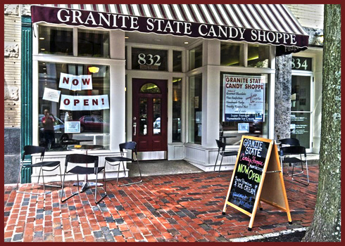
Building Engagement
Find the sweet spot
Further their mission
Accountability requirements
What keeps them up?
Notes:
It’s all about finding the sweet spot: how can the partnership help them achieve their own mission/vison of why they exist. Meet performance accountability requirements (HEDIS, MCH 3.0 performance metrics, or meet their interests – what keeps them up at night???? How can you be the solution to their problem?
Involving pediatric care practices: choose a grassroots approach. Going on site with presentations (with CME), learn about their burning issues – what needs to they have like CME, MOC, bring food if you can – coincide with a staff meeting, have something active they can do (project you are enrolling for).
Be ready to connect the dots between what they do and your work….be prepared to explain the linkages that may not be readily apparent.

Slide 22
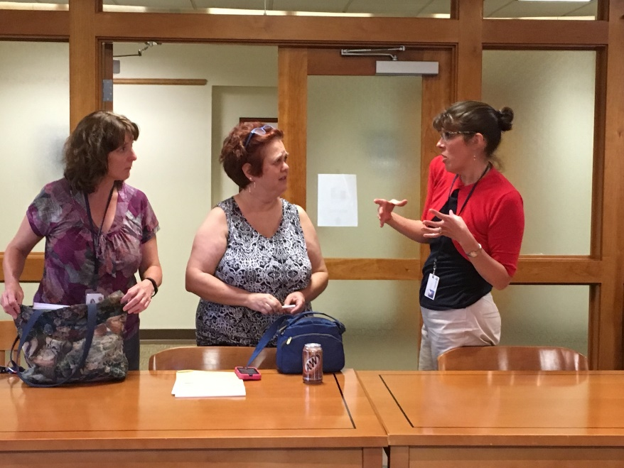
Maintaining Engagement
Seek their input feedback constantly
Feedback progress and results
Mtg time and value is everything
Notes:
Seek input example: Adolescent health – story of discussion we had of our IP stakeholders as we were thinking of applying….one of clinicans brought up impact school policy can have on demand for services as well as importance of having visit in context of teen’s medical home. Quality of services – Medicaid MCOs – one of QIP is improving chlamydia screening rates as they are very low and in light of recent report from state epidemiologist about
Feedback progress and results – of what you did – what forward momentum you made based on the feedback received. Let them know that you listened and are acting on it. Proposal for AYAH CoIIN ideas – feed it back to them. CME was looking for input on movement to pediatrics to value based payment models – canvassed our stakeholders about their thoughts coupled this with
Meeting time: we meet quarterly, in the evening (5-7pm) Helpful for providers, payers, after office hours, but is after a full day. Provide a valuable experience – bring to them new information (updates on our projects, guest speakers from other QI projects, reviewing data from a survey project (really like reviewing data), and engage them meaningfully –back up to adolescent health discussion. Providers and payers walked out of the meeting – that was awesome.
Provide value in connecting people to programs and resources that are in or are coming to their area. Help them be “in the know”. For example, we are part of state HPV collaborative. This collaborative got a grant to do mobile vans for HPV screening. We stated --- have your connected with the providers in that area about your project to Forward screening results back into the medical home? Linked the project contact to the Pediatrics Dept. Chair in that area.

Slide 23
Tips
Use existing networks
National Improvement Partnership Network
IPs in NJ, IN, MD, MN
Regional Health Improvement Collaboratives
http://www.nrhi.org/about-collaboratives/
Washington, NJ
Other multi-stakeholder state health reform efforts
Canvas your team – relationships to build upon
Develop one pager
https://www.nhpip.org/sites/default/files/user-uploads/NH%20PIP%20one%20pager%20102416.pdf
Notes:
independent, non-profit organizations comprised of multiple stakeholders who come together to improve health and healthcare. To be a Regional Healthcare Improvement Collaborative, four key stakeholders need to be at the table and actively involved in organizational governance and health system improvement:ealthcare providers
Healthcare payers
Healthcare purchasers
Healthcare consumers
Develop one pager – who you are and what you do and where you are going – use this in your conversations with new stakeholders.

Slide 24
Tips
Finding the sweet spot
Pediatric Quality Measure | HEDIS | CHIPRA | NH MCH 3.0 | PCMH | NH Medicaid QI | MCO Perf. Impr Project
Adolescent well-care visits | X | X | X | X | X
% sexually active young women (16–24 yrs) tested for chlamydia | X | X |  | X | X | X (1MCO)

Slide 25
Phone #: (866) 865-2157 Conference Code: 867-002-3759
Phone #: (866) 865-2157 Conference Code: 867-002-3759
Questions???

