Slide 1
Judy Klein
President, UNITY Consortium

Slide 2
Beliefs on Adolescent Health and Vaccination:
Results From a Unity U.S. Survey
SAHM
March 2018 www.unity4teenvax.org

Slide 3
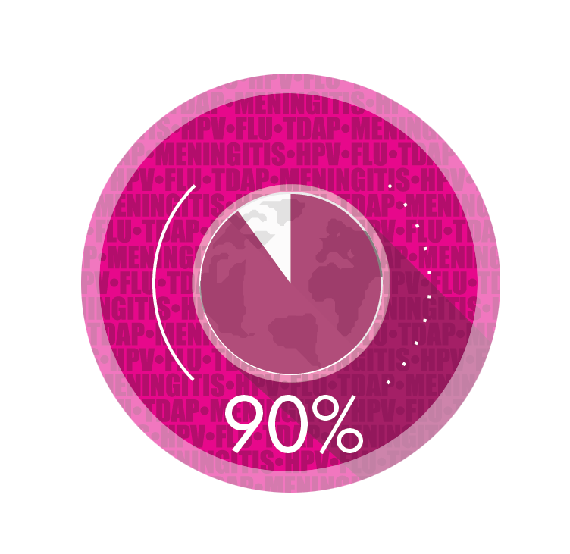

UNITY Vision and Mission
MISSION: Provide action-oriented leadership, innovation and education on preventive health and immunization for adolescents and young adults:
DEVELOP
healthcare providers as advocates that make strong recommendations for all
nationally recommended
vaccines.
ESTABLISH
immunization
as a central component of preventative health and as an investment in lifelong health.
VISION
ENGAGE parents, adolescents and young adults to embrace the value of immunization.
ENSURE
easy access to and timely delivery of all recommended vaccines.
Coverage is 90% or greater
for all nationally recommended vaccines for adolescents and young adults
1

Slide 4

Survey Objectives
Understand parents, teens and healthcare providers views on health prevention and immunization
Gather data to educate and align parents, teens, and healthcare providers around the clear and certain value of immunization to life long health
Notes:
Results of large US survey conducted by Harris Poll with teens, parents of teens, physicians and pharmacists regarding their beliefs on adolescent health and immunization.
….prepare parents, teens, and HCPs for successful discussion on immunization (concise discussion resulting in vaccination)

Slide 5
Topline U.S. Survey Results - Methodology
Conducted by Harris Poll, Sept-Oct 2016
20 minute, online, self-administered survey
Participants
Teens (n=506): split by teen’s age 13-15/16-18 & gender
Parents (n=515): split by teen’s age 13-15/16-18 & gender
Healthcare Providers (n=510): PCPs/Pediatricians (n=405) and Pharmacists (n=105)
Notes:
Adolescent vaccination physicians and pharmacists

Slide 6
Unity Survey U.S. Results - Overview
Attitudes Towards Adolescent Preventive Health
Adolescent Health – Roles and Responsibilities
Vaccination –Roles and Responsibilities
Vaccination

Slide 7
Attitudes Towards Adolescent Preventive Health
Staying healthy is very or extremely important to virtually all teens and their parents
General consensus between parents and teens on what is important for teens staying healthy
More important
Teens are genuinely interested in living a healthy lifestyle and taking more responsibility for their health, yet only half of doctors agree that teens welcome being accountable
Keeping safe from STDs, avoiding alcohol/drugs/ smoking, getting enough sleep, eating healthy
Less important
Getting all recommended vaccines, flu shots, seeing a doctor

Slide 8
Health Today Vs. Future
  Gap between HCP and teen–parent beliefs
Virtually all healthcare providers agree that many teens think things they do now will not have a big effect on their health in the future.
Things I do now will not have a big effect on my health in the future
(% Strongly/Somewhat agree)
n=506 | n=515 | n=405 | n=105
Notes:
BIG gap between with HCPs think about teens and what teens actually believe (and parents)
BASE: ALL QUALIFIED RESPONDENTS
Q145. How much do you agree or disagree with each of the following statements about your health? “Things I do now will not have a big effect on my health in the future”
Q165. How much do you agree or disagree with each of the following statements about your son/daughter health? “Things my son/daughter does now will not have a big effect on his/her health in the future”
Q150. How much do you agree or disagree with each of the following statements about teens health? “Many teens think that things they do now will not have a big effect on their health in the future”

Slide 9
Responsibility for maintaining good health
Teens look to parents for health advice, are comfortable having an open dialogue, and appreciate their parents being actively engaged in health decisions. However, a minority of HCPs believe that teens are comfortable talking to parents about their health.
76%
teens
I need my parents/guardians to help me stay healthy
89%
teens
32%
docs
45%
pharm
I am comfortable asking my parents/ guardians questions about my health
Teens usually feel comfortable talking to parents about their health
62% of teens say they are anxious when making decisions about their health
Notes:
Parents (followed by doctors) are….
the overwhelming top health resource for teens, both in terms of access and trust
Teens’ first stop for questions related to health
(66%)
The most trusted resource for health related information
(94%)

Slide 10
Frequency of teen well visits
Most physicians agree that teens should have well visits at least once a year. However, physicians report that on average only about half of their teens actually have annual well visits.
How often should all teens have well visits?
Only 56% of teens have annual well visits, according to physicians
Notes:
Base: All Qualified Physicians (n=405)
Q205. In your opinion, how often should all teens (ages 13-18) have well visits?
Q210. Of all the teen patients (ages 13-18) in your practice, approximately what percentage have annual well visits (including school physicals)?

Slide 11
Attitudes about seeing a doctor
Teens and parents share misconceptions about not needing to see a doctor unless they/their teens are sick.
Physicians and pharmacists agree that these misconceptions exist.
Don’t see why I should see a doctor or other healthcare provider if I feel healthy
(% Strongly/Somewhat agree)
Teens only go to the doctor
when they feel sick
(% Strongly/Somewhat agree)
Y
n=506 | n=515 | n=405 | n=105
Notes:
BASE: ALL QUALIFIED RESPONDENTS
Q145/Q165/Q150 How much do you agree or disagree with each of the following statements about your health?
“I don’t see why I should see a doctor or other healthcare provider if I feel healthy”/ “I don't see why my son/daughter should see a doctor or other healthcare provider if he/she feels healthy”/ “Many teens do not understand why they should see a doctor or other healthcare provider if they feel healthy”
“I only see a doctor or healthcare provider when I feel sick”/ “My son/daughter should only see a doctor or other healthcare provider when he/she feels sick”/ “Many teens do not understand why they should see a doctor or other healthcare provider if they feel healthy”

Slide 12
Parent’s presence in doctor exam room
Most parents remain for some or all of the doctor visit, and leave only at the request of their child or doctor. Often parents insist on staying in the room and acknowledge that their presence changes the dialogue.
61% of teens report that their parents were in the room the entire time during their last visit
Parents insist on staying in the exam room during my doctor visits
53%
47%
63%
49% of parents report that they were in the room the entire time during their child’s last visit
Parents encourage me to ask my HCP questions about my health
87% of teens find their parents’ presence during a visit to be reassuring
85%
95%

Slide 13
Time alone with physician in exam room
That said, there is a general consensus that spending time alone in the examining room with a physician is crucial and helps teens take more ownership over their own health.
It’s important to have time alone to talk with doctor
(% Strongly/Somewhat agree)
67%
84%
97%
Spending time alone with doctor makes me/teens feel more responsible for my/their health
(% Strongly/Somewhat agree)
78%
80%
96%

Slide 14
Comfort level and engagement
The parent role remains essential because teens themselves don’t seem ready to engage fully on their own. Overcoming a lack of comfort in the exam room may be an obstacle that needs to be addressed for teens to take on a larger role.
Comfort
Engagement
Only about 4 in 10 Teens are comfortable without their parent in the room …
Physicians feel that (particularly younger) teens are not engaged without their parents
Younger Teens
Older Teens
32%
54%
Teens want parents to be engaged in the decisions about their health
(% Strongly/Somewhat agree)
87%
89%
74%
99% of Physicians believe that teens should be encouraged to be more engaged

Slide 15
Vaccination decisions – Parent influence
According to both teens and parents, parents are the ones who have most influence over vaccinations, followed by HCPs as a distant second.
Who do you think has the most influence over whether or not you [your son/daughter] receives a vaccination?
Notes:
Base: All Qualified Teen [Parent] Respondents (teens total n=506, parents total n=515)
Q320. Who do you think has the most influence over whether or not you [your son/daughter] receives a vaccination?

Slide 16
Judy@unity4teenvax.org

Slide 17
APPENDIX

Slide 18
Demographics
Physicians
Gender:
Male | 57%
Female | 43%
Mean age: | 42.4
Mean # of patients see in typical month: | 443
PCP | 63%
PED | 37%
Teens
Gender:
Male | 51%
Female | 49%
Age:
13-15 | 54%
16-18 | 46%
Ethnicity:
White | 56%
Hispanic | 22%
Black | 10%
African American | 4%
Asian or Pacific Islander | 4%
Mixed racial background | 2%
Native American or Alaskan native | 1%
Decline to Answer | 1%
Parents
Gender:
Male | 44%
Female | 56%
Age:
Under 35 | 13%
35-54 | 70%
55+ | 17%
Mean | 45.2
Ethnicity:
White | 66%
Hispanic | 17%
Black | 8%
African American | 3%
Asian or Pacific Islander | 2%
Mixed racial background | 1%
Decline to answer | 2%
Age/Gender of Child:
Male 13-15 | 24%
Male 16-18 | 24%
Female 13-15 | 27%
Female 16-18 | 26%
Pharmacists
Gender:
Male | 55%
Female | 45%
Mean age: | 49.9
Setting
Pharmacy chain | 42%
Independent pharmacy | 30%
Local grocery/food store | 14%
Big-box/super center | 9%
Other | 5%
Base: All Teens (n=506)

