Slide 1
Introductions
Staff
MCHB Attendees
Youth Attendees (names not included)
NAB Members

Slide 2
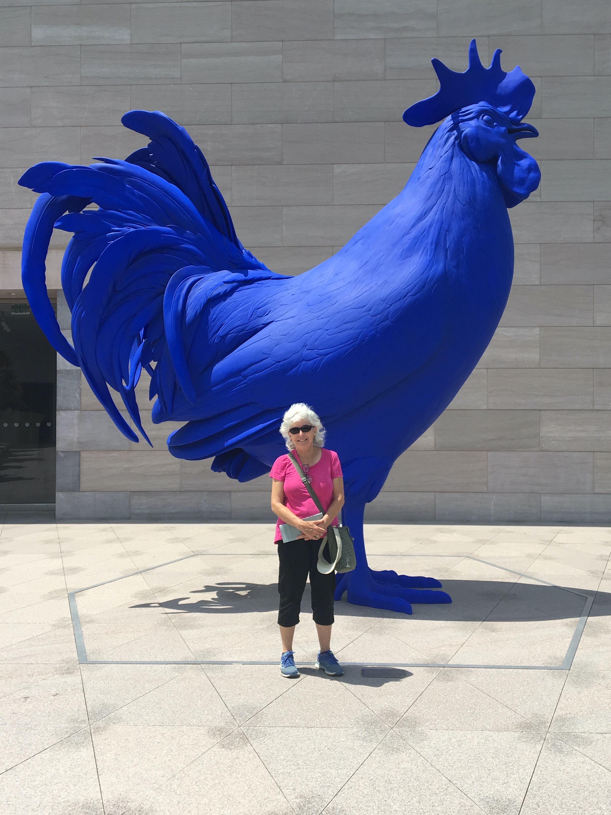
Sally Adams
I used a rotary dial phone to connect when seeing each other in-person was not possible. Connecting with out of town peers generally involved letter writing, which I enjoyed.

Slide 3
Lynn Bretl

Slide 4
Claire Brindis
Telephone calls and writing notes or letters were primary source of connecting

Slide 5
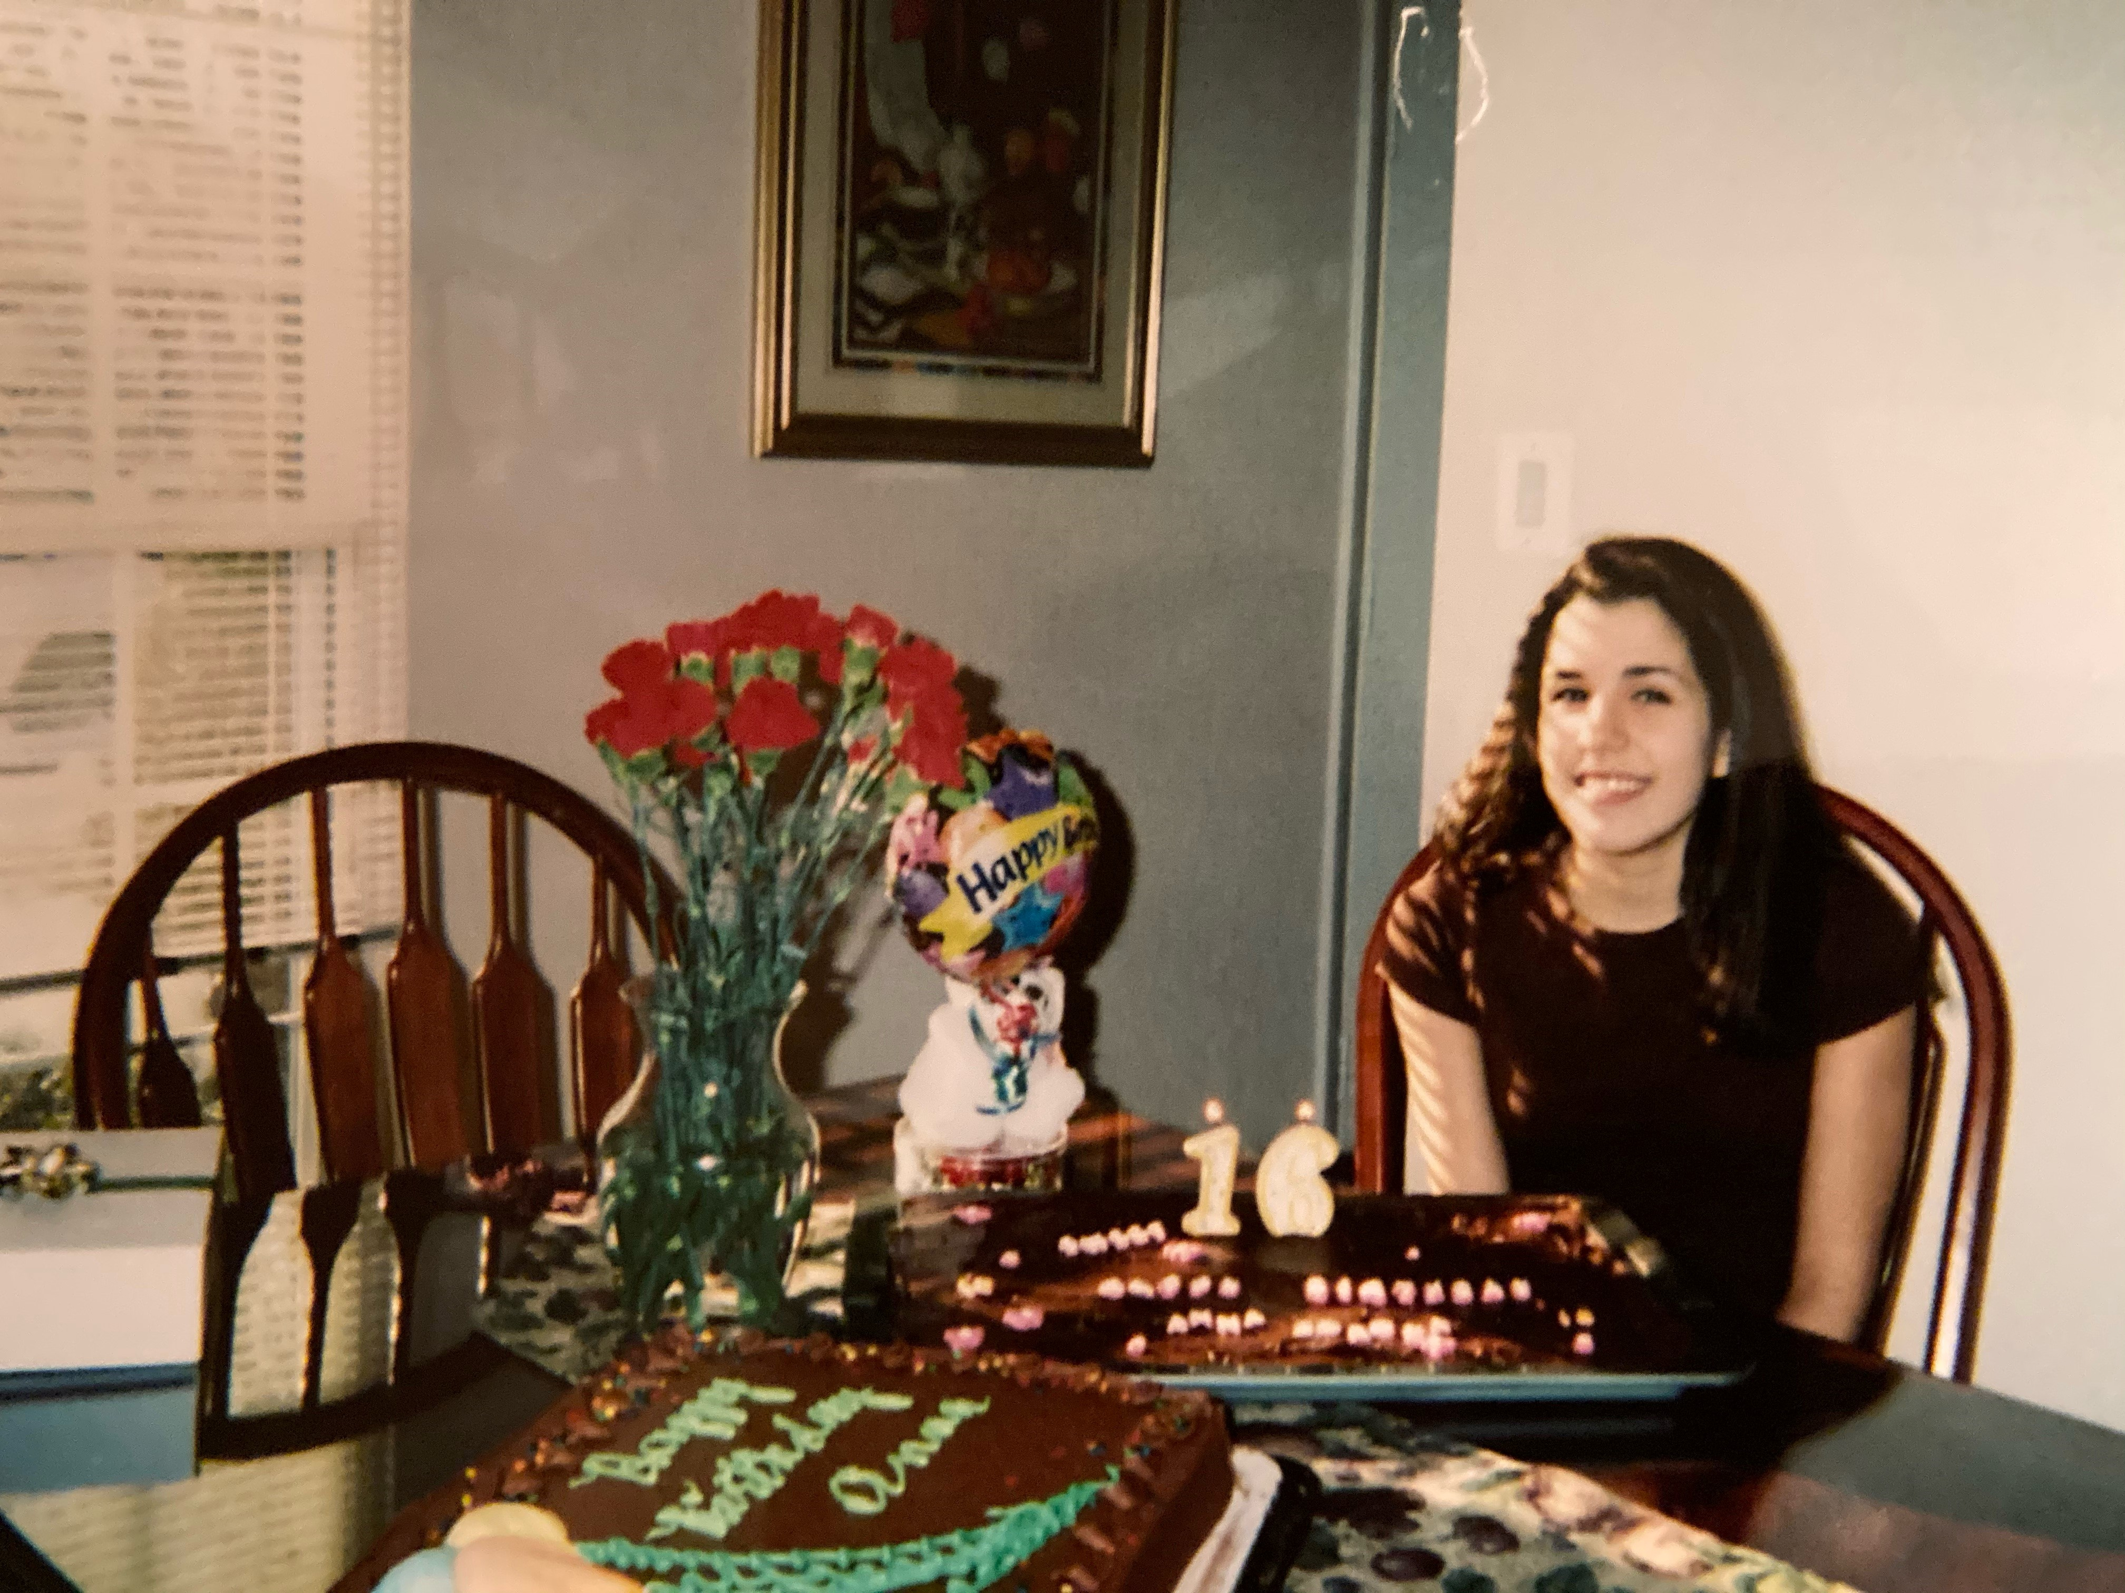
Anna Corona
AOL Instant Messenger and a house line featuring a special ring just for my friends

Slide 6
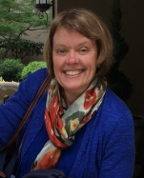
Wendy Davis
I connected with peers outside of in-person gatherings by (old-fashioned, land line) telephone and letter writing.

Slide 7
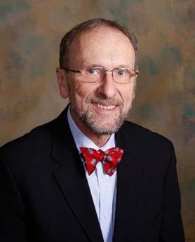
Charles Irwin
I had a pen-pal from Japan and we communicated through letters until I went to college. We recently re-connected through email after having lost contact for over 50 years.

Slide 8
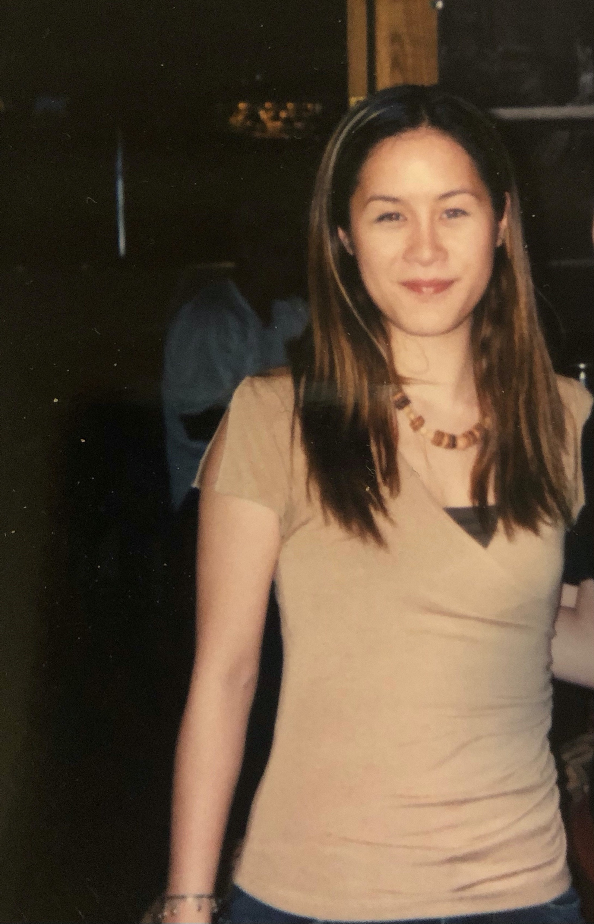
Jennifer Le
By phone (landline, cord and cordless telephone), handwritten notes passed in class/hallways, AOL Instant Messenger, and MySpace (before Facebook took over).

Slide 9
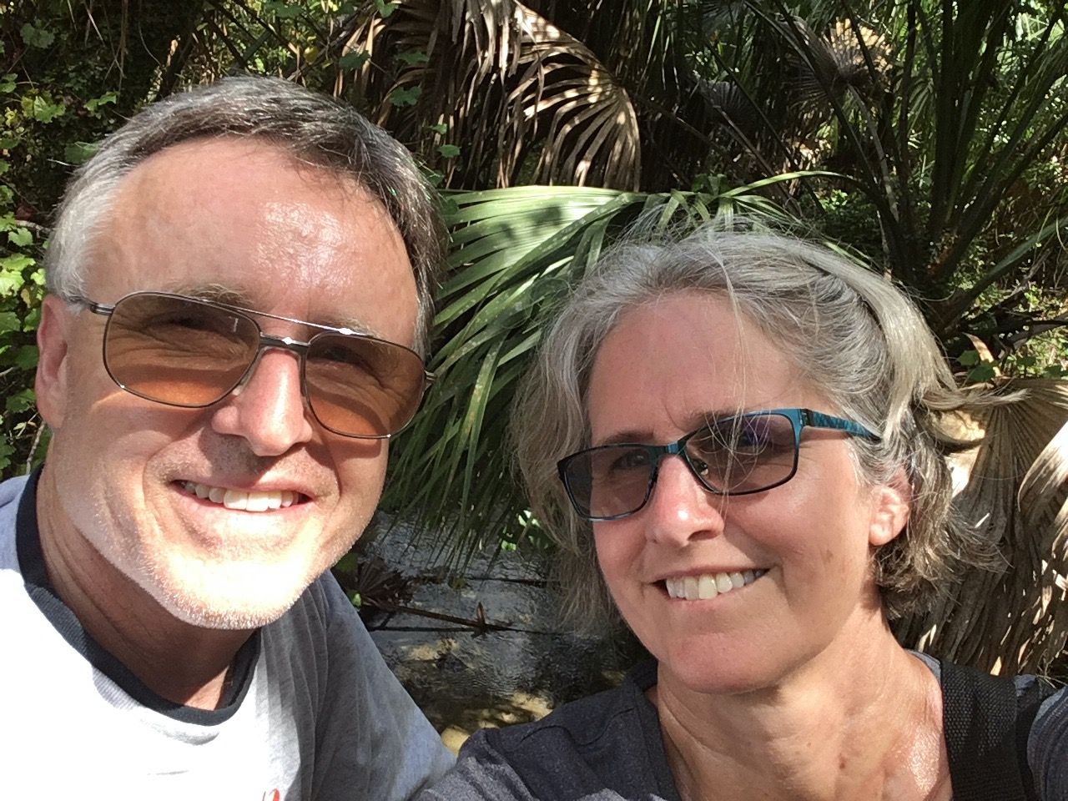
Jane Park

Slide 10
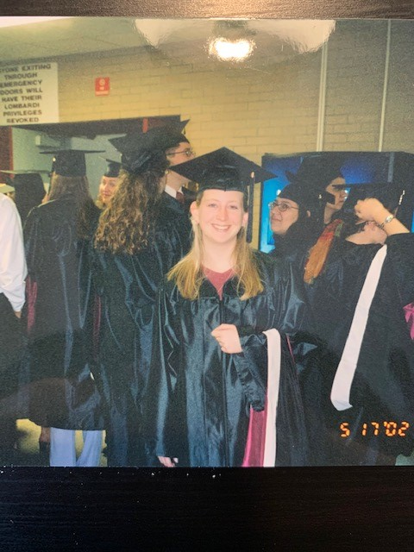
Caroline Stampfel
I have a box of letters that my friends and I wrote to each other; some were sent via mail, and some were dropped in each other’s lockers.

Slide 11
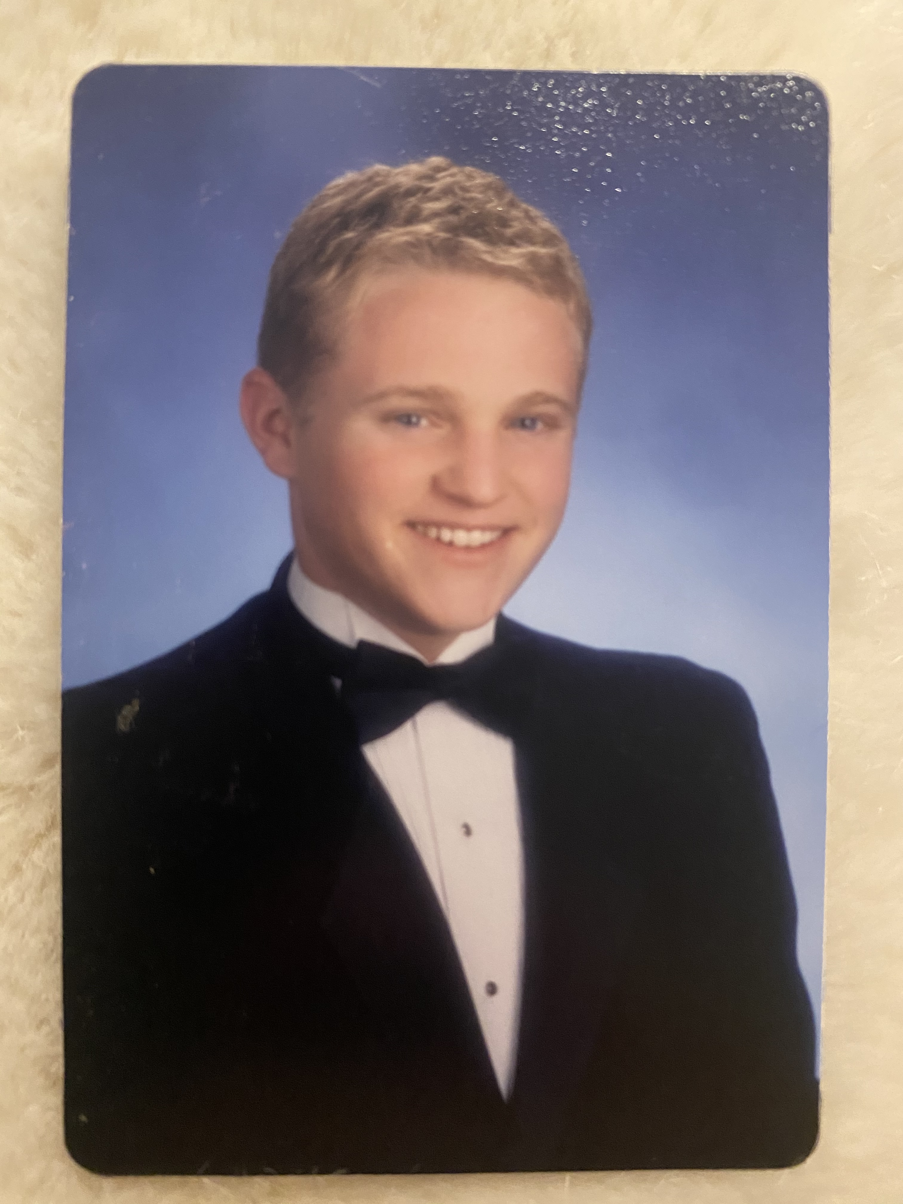
Jason Schaub
Definitely began with the ”house phone”... but by college we were in the iPhone era.

Slide 12
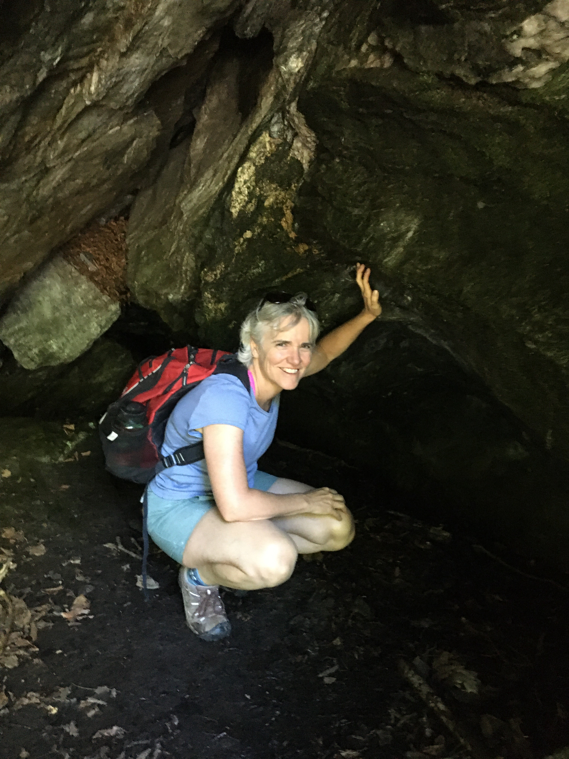
Rachel Wallace-Brodeur
I had a pen pal in Nebraska and we would write each other letters and send pictures of things we were doing.

Slide 13
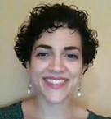
Iliana White

Slide 14
Other Staff
Renee Sieving
Susan Richardson

Slide 15
Sara Kinsman

Slide 16
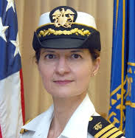
Pamella Vodicka
My favorite form of communication was in a group… as you can see, I was exhibiting early signs of my interest in food & nutrition!

Slide 17
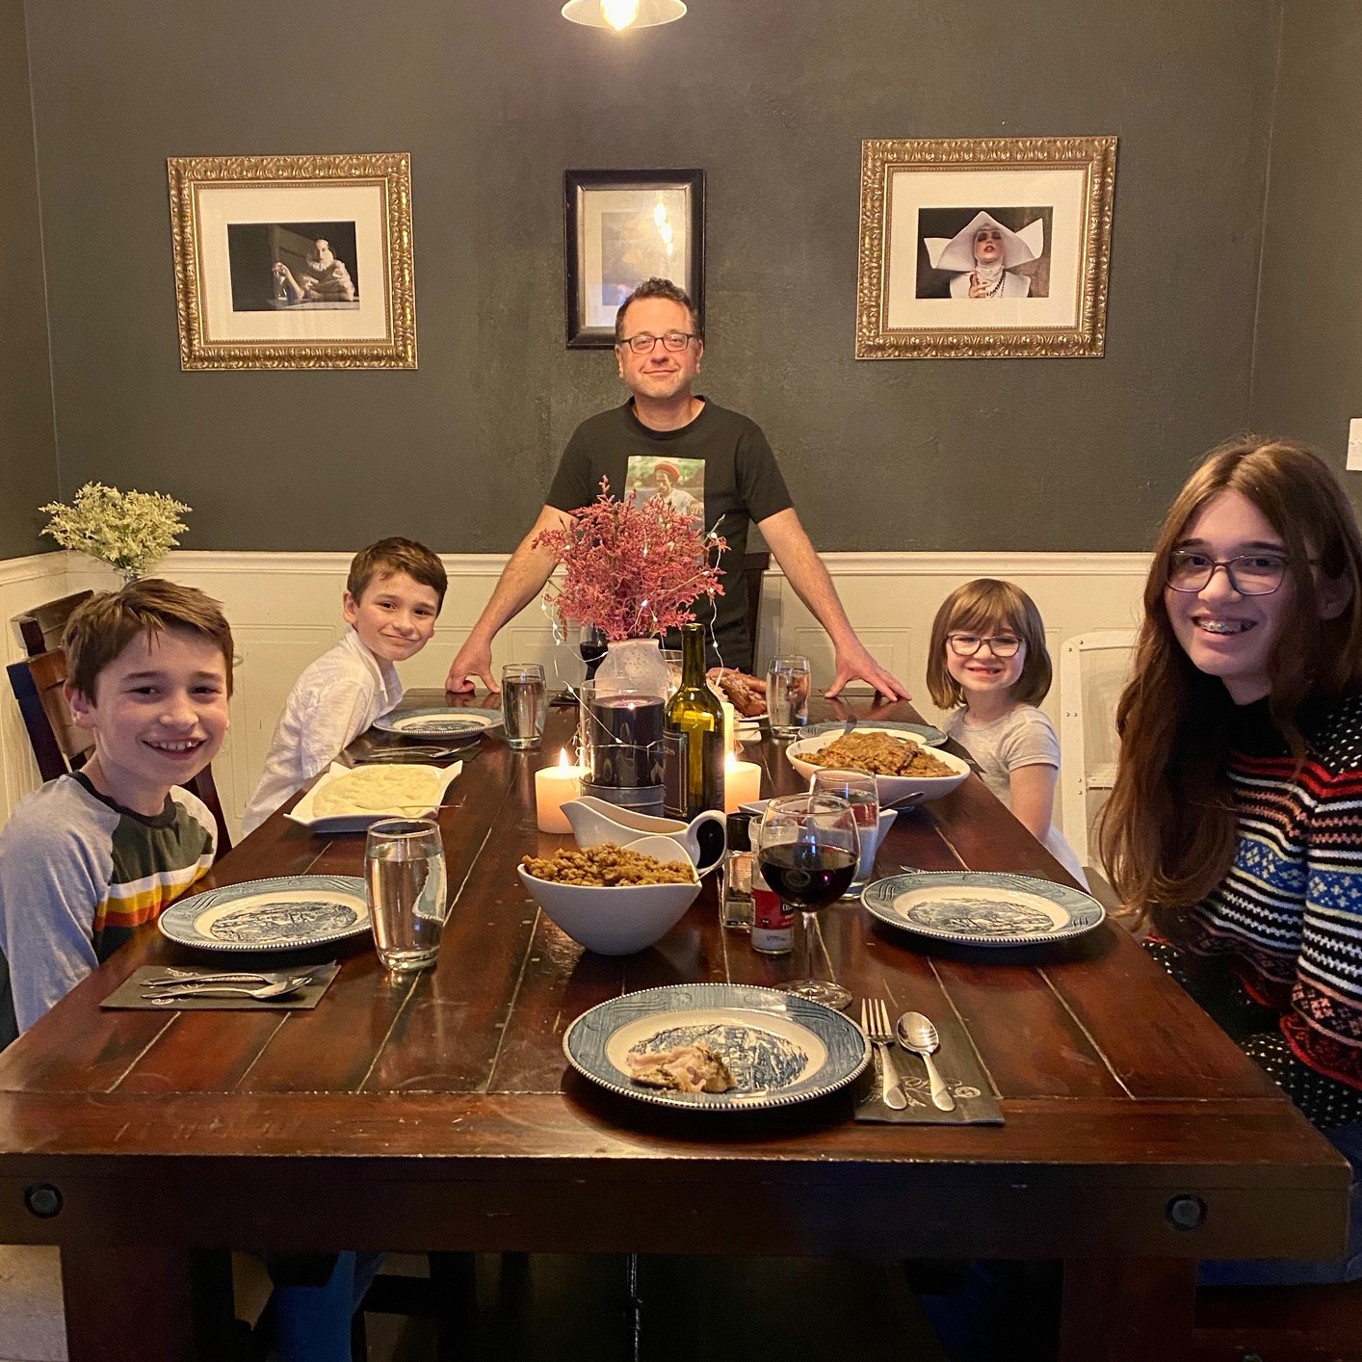
Chad Abresch
Passing notes or talking on the phone.

Slide 18
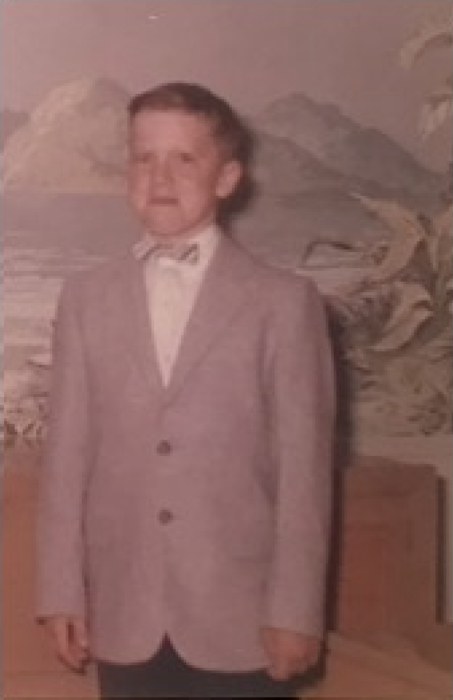
Dennis Barbour
All of my peer connections were together in common physical spaces. Technology was not an issue at that point.

Slide 19
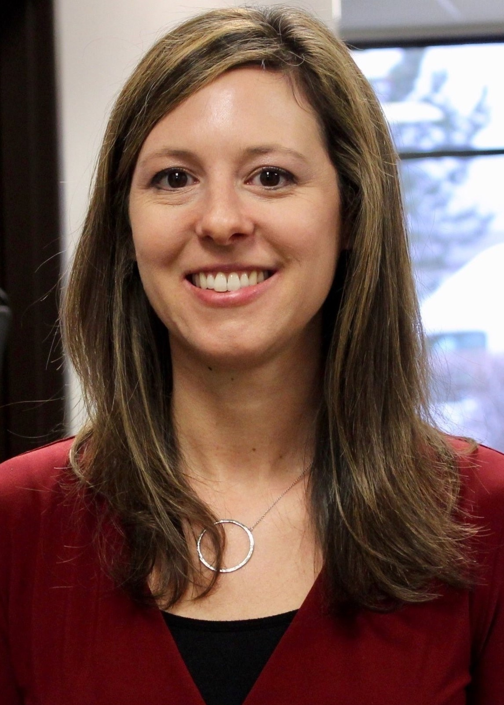
Christina Boothby

Slide 20
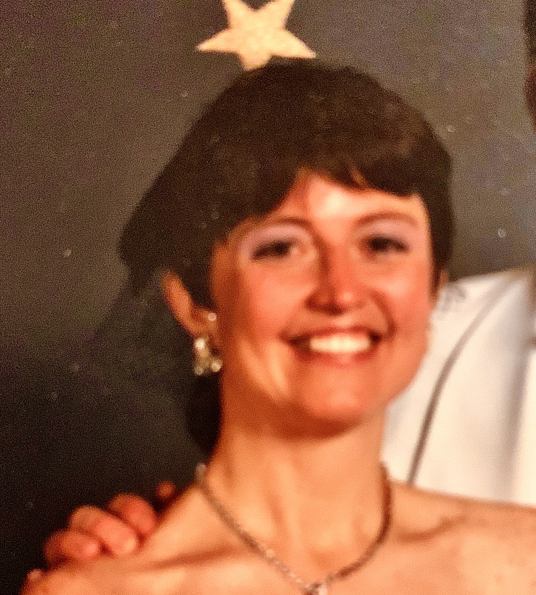
Cora Breuner

Slide 21
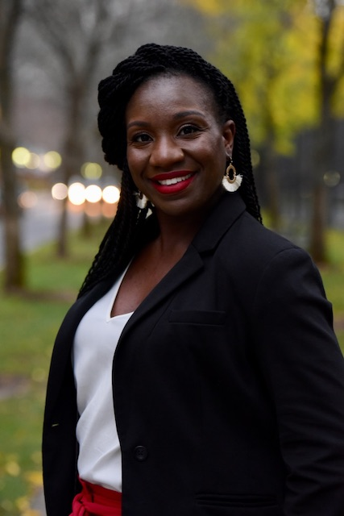
Stephanie Campbell
Connecting on the telephone and AOL Messenger

Slide 22
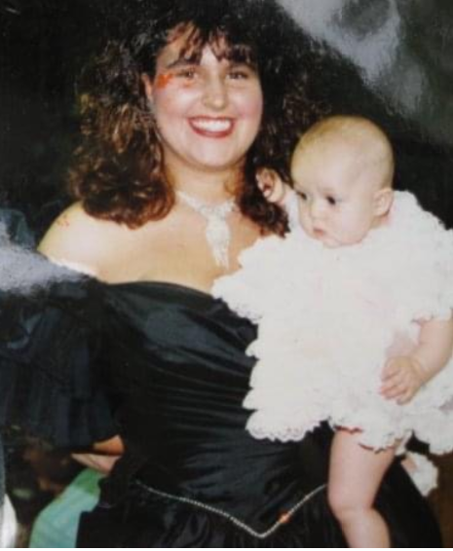
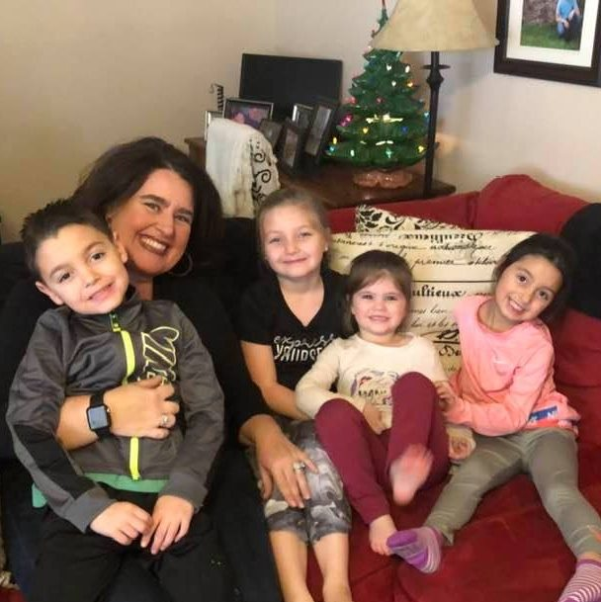
Paula Fields
Primary connection with peers occurred via the telephone… yep, I am the age that cell phones, internet, and Facebook did not exist, ha!

Slide 23
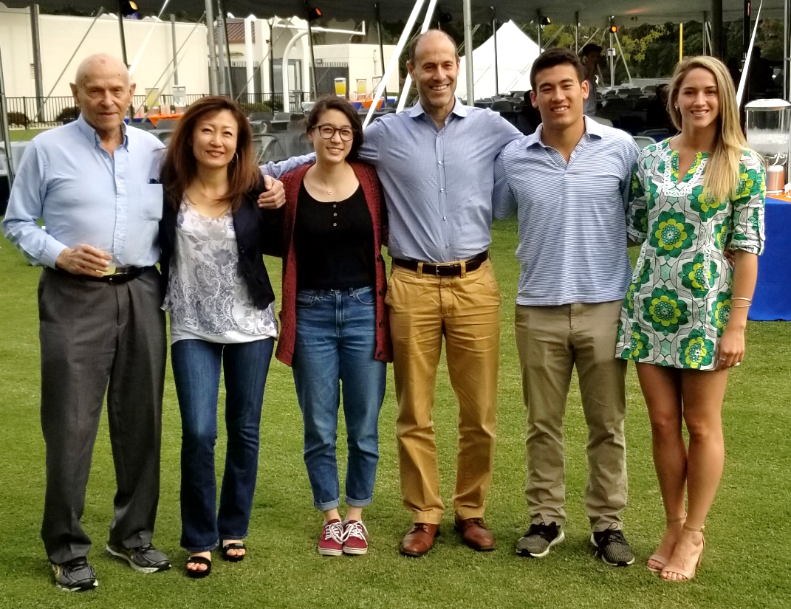
Sion Harris
It was really by phone (the ones that actually plugged into the wall and stayed put when we left the house), or by mail. I still have some letters that I received from friends, and even a pen pal from Italy!

Slide 24
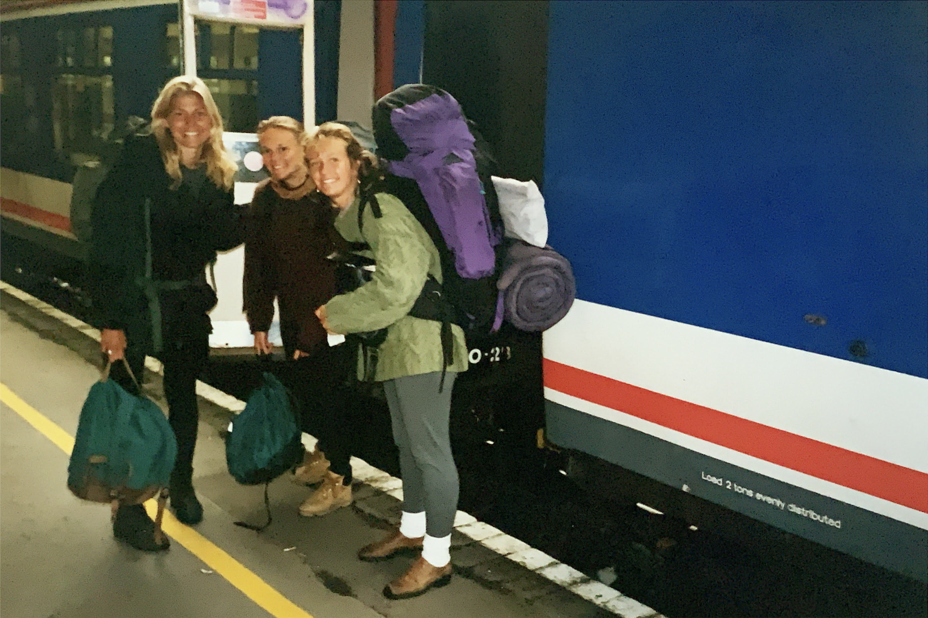
Sharon Hoover
Lots of 3-way calls in middle school! We also used chat rooms and I had a few pen pals I’d write letters to!

Slide 25
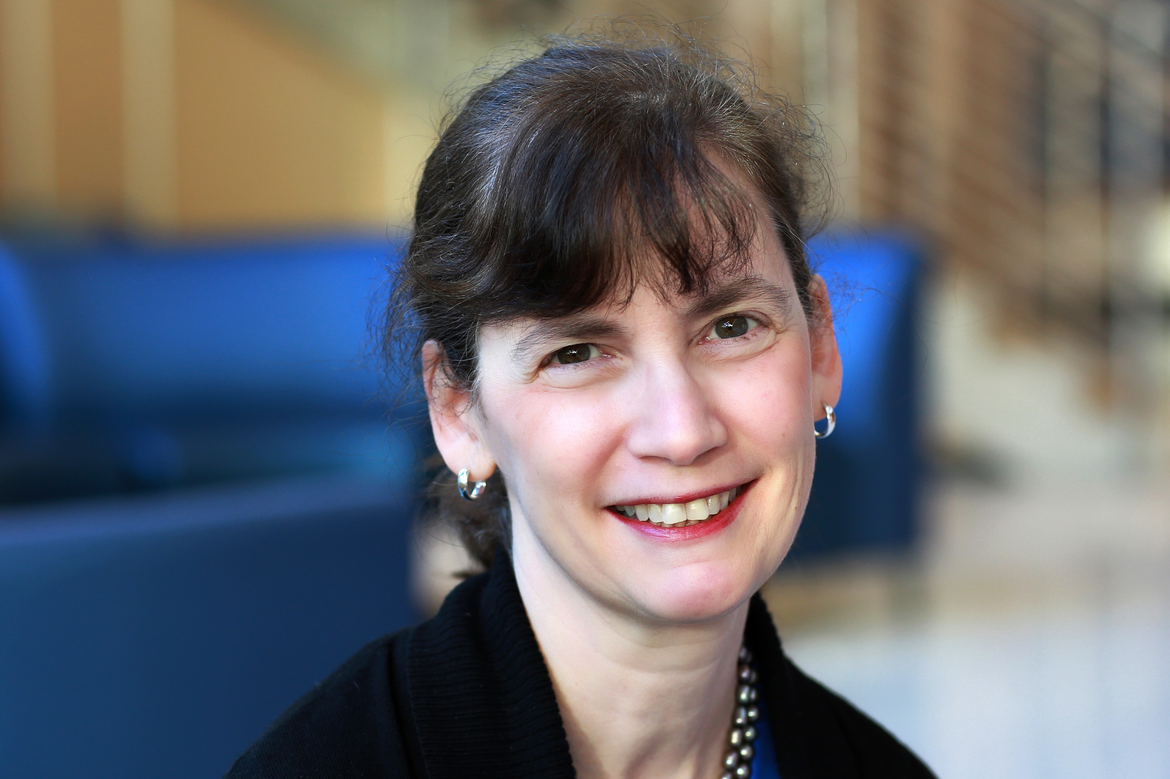
Jessica Kahn

Slide 26
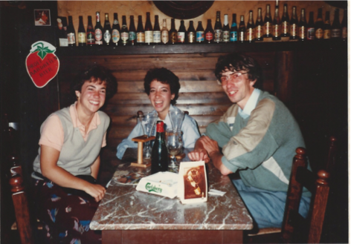
Judy Klein
On the phone, long phone calls every day, with the phone fought over by siblings for their turn!

Slide 27
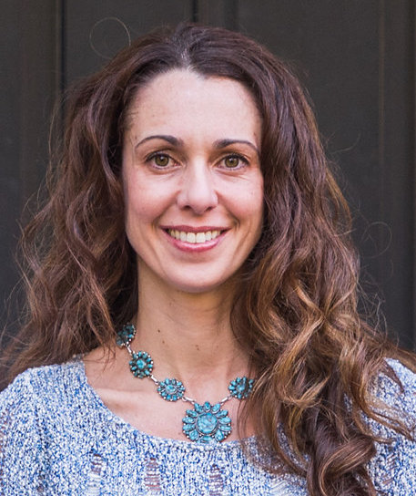
Jennifer Leonardo
I connected with peers by writing letters, passing notes, and through phone calls.

Slide 28
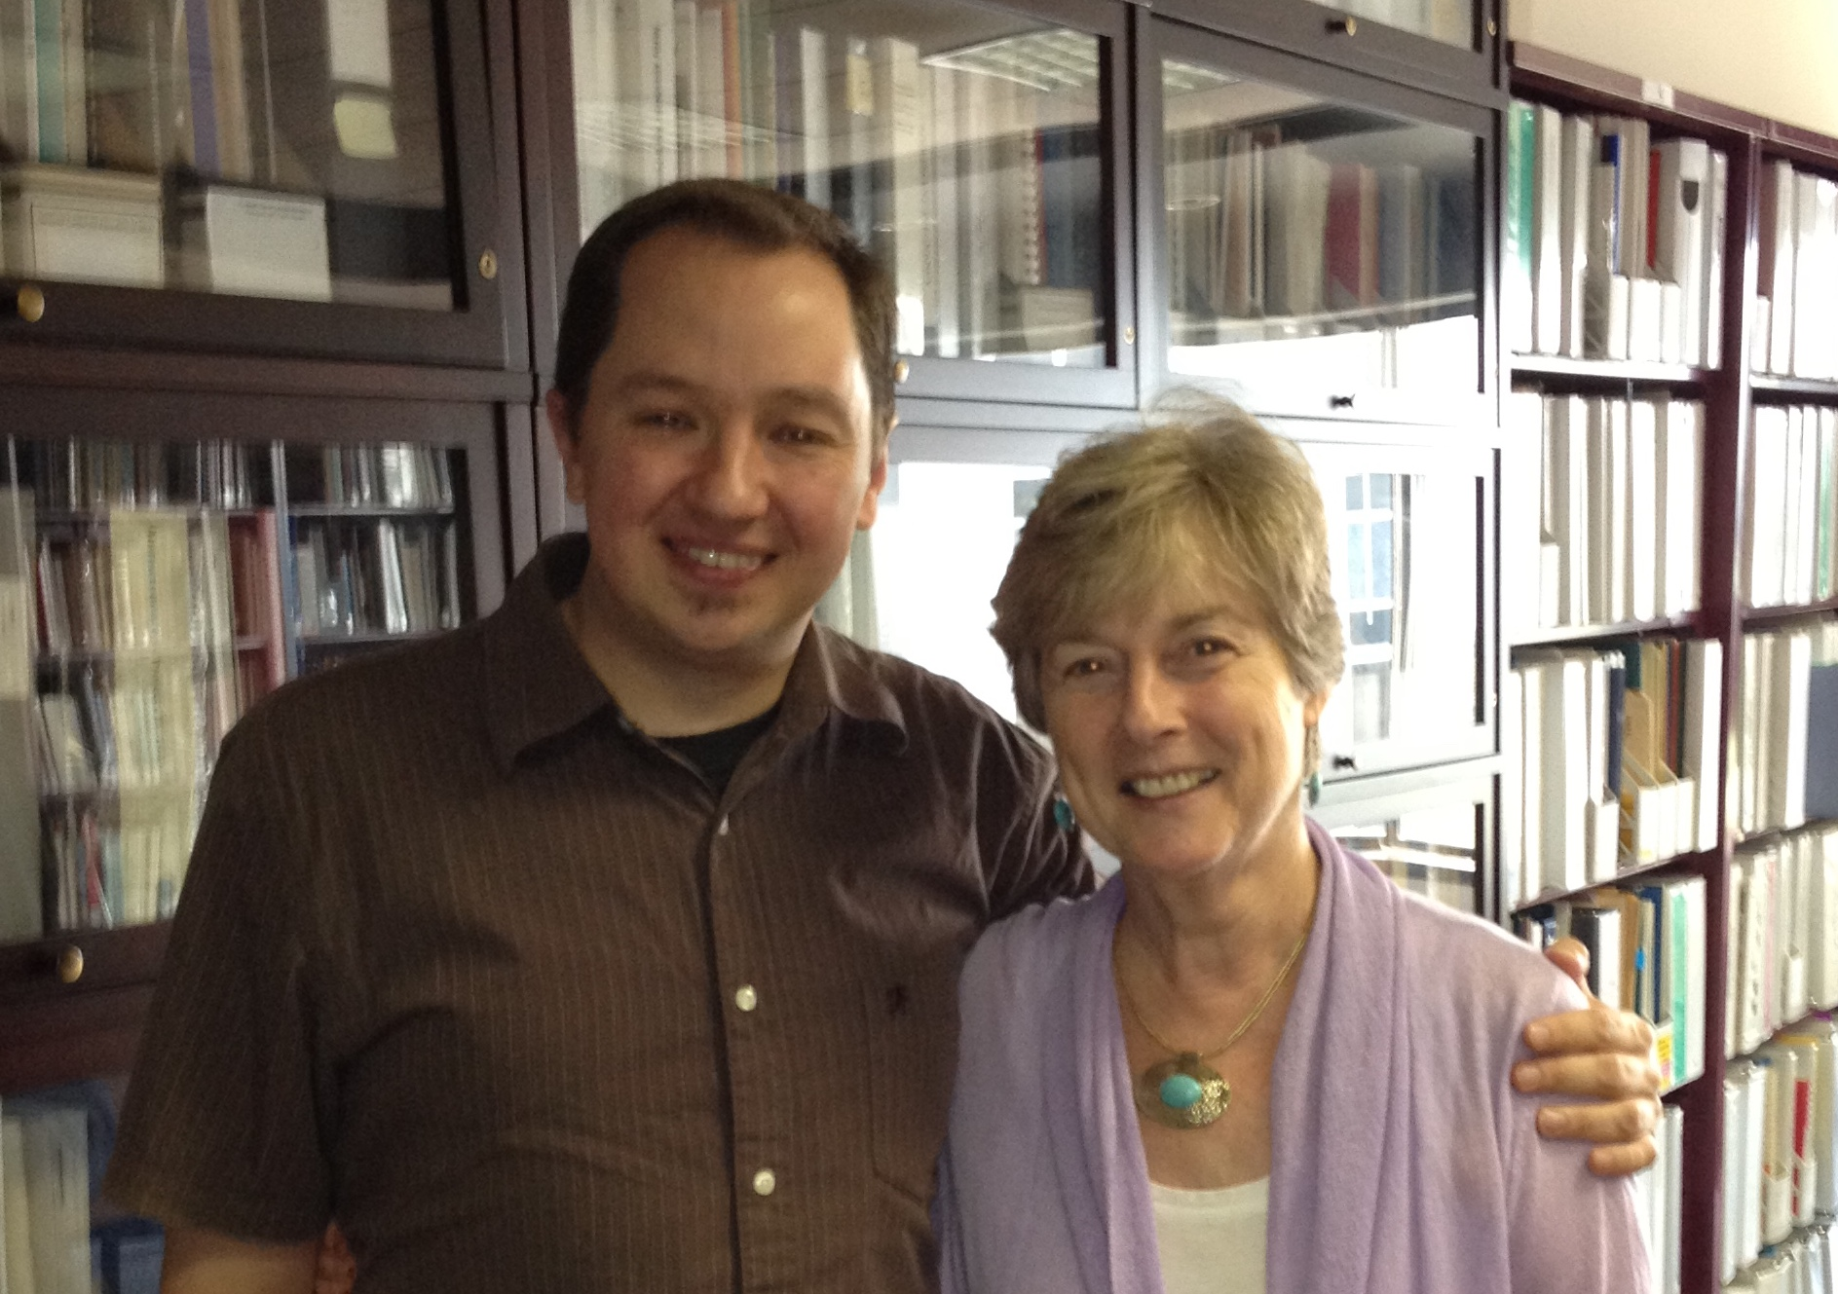
Rochelle Mayer
The highly coveted coming-of-age gift of a phone with your own phone number so that you could sequester in your bedroom… That's where I learned to shelter in place!

Slide 29
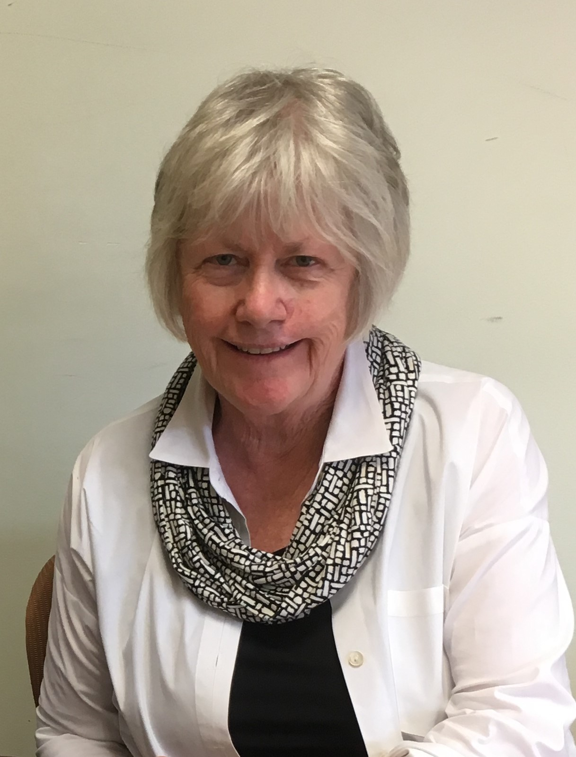
Peggy McManus
Via phone, a party line. I waited till the other person was finished with their conversation, and then I could talk!

Slide 30
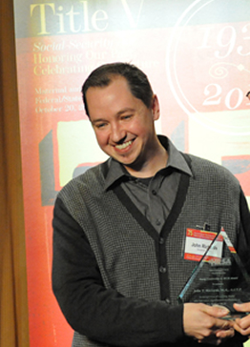
John Richards
The telephone was a lifeline.

Slide 31
Dana Yarbrough
We used the house rotary phone to connect to friends. We even were on a 'party line’… that was not fun when you wanted to spend an hour talking to the friend you just saw and the other house needed to use the phone!

Slide 32
Other Partners
Erin Hemlin
Devin Jopp
John Santelli
Colleen Sonosky
Unable to attend
Karen van Landegham
Lew Margolis
Cate Wilcox

