Slide 1
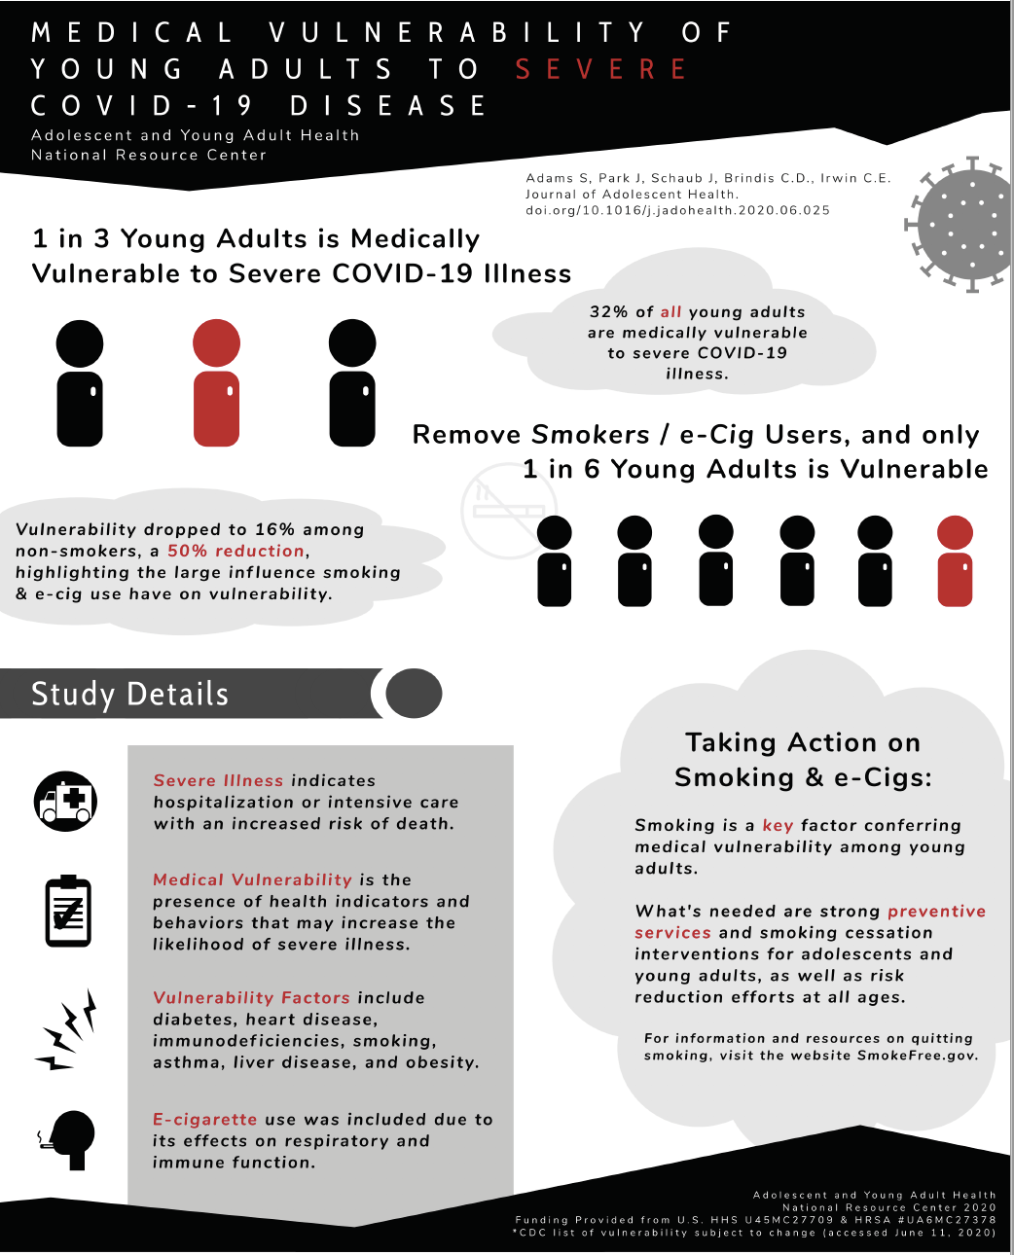

UPDATE: Young Adult Team
GOAL:
Increase to 25% the percentage of all 59 states and territories with a State performance (SPM) or outcome measure (SOM) focusing on or including a major focus on young adults, approximate ages 18-25.
Activities:
Report with Young Invincibles on digital & peer-advocacy projects to expand access to and destigmatize mental health services for college-age youth
Updated Clinical Preventive Services Guidelines for young adults.
AYAH-NRC National Advisory Board 10/14/20

Slide 2
Activities:
Created compendium of strategies to advance young adult health.
Completed analysis on risk to young adults for severe COVID-19 disease, as a result of smoking
  **Adams S, Park MJ, Schaub J, Brindis C, Irwin CE, Jr., Medical vulnerability of young adults to severe COVID-19 illness—Data from the National Health Interview Survey. J Adolescent Health.
  [Epub ahead of print].
AYAH-NRC National Advisory Board 10/14/20

Slide 3
Activities:
Developed young adult specific resources:
  Young Adults & MCH: 15 min video that outlines where and how MCH programs intersect with Young Adults.
  10 Things MCH Should Know About Young Adults : 20 min video that provides an overview of Young Adults as a demographic in the U.S & highlights key health measures.
Developed Young adult webinar series:
  Webinar #1: Young Adult Health: What Makes Them Unique?
  Webinar #2: Young Adult Mental Health & Suicide Prevention
  Webinar #3: Young Adult Male Health
AYAH-NRC National Advisory Board 10/14/20

